Slide 1
Family Educational Rights and Privacy Act (FERPA)
Jesh Humphrey
Deputy General Counsel
October 15, 2015

Slide 2
Topics We’ll Cover
FERPA overview
And how it applies to . . .
  Advising
  Teaching
  Writing letters of recommendation
  Dealing with parents

Slide 3
Overview
Family Educational Rights and Privacy Act (FERPA) is a federal law that:
  protects students’ education records from being disclosed without consent and
  permits students to have access to their own education records
University Policy 402, Student Records
  explains how FERPA applies on our campus
  http://legal.uncc.edu/policies/up-402

Slide 4
Student Rights Under FERPA
Students’ FERPA rights:
  To inspect their education records;
  To prevent disclosure of their education records;
  To seek amendment to their education records if believed to be inaccurate or misleading;
  To be notified of their privacy rights under FERPA; and
  To file a complaint with the U.S. Department of Education concerning an alleged failure by the university to comply with FERPA.

Slide 5
Who is covered?
Who is covered by FERPA?
  Living students currently attending or who have attended at any time in the past, and only to information collected about them while they were attending (or information gathered post-attendance that is directly related to the students’ attendance).
NC Public Records Act treats records of applicants (whether admitted or not) as confidential even though that is not required by FERPA

Slide 6
What is covered?
What is an “education record” according to FERPA?
  Information that is directly related to the student and
  Maintained by the university.

Slide 7
“Maintained and “Directly Related”
FPCO Interpretation
Testimony of FPCO Director LeRoy Rooker, U.S. Department of Education Safe And Drug-free Schools And Communities Advisory Committee Meeting, February 21, 2007:
“Virtually anything that is maintained at a public school on a student that is identifiable to the student is going to be an education record. This includes things like handwriting, video/audio tapes, computer media, microfilm, microfiche. Any means by which those records are maintained.
To be directly related means in some way it's going to be personally identifiable to that student. Personally identifiable includes the student's name, a social security number, a student ID number. Also includes other information to make the student's identity easily traceable so if you've got something where information is de-identified, then it's not directly related.”

Slide 8
Education Records
What is not an education record?
  Campus police records
  Employment records (unless dependent on status as student)
  Medical/counseling records
  Non-circulating faculty or staff records made for personal use
  Peer-graded assignments BEFORE collected by instructor
  Certain alumni records

Slide 9
Directory Information
Directory information is exempt from FERPA confidentiality requirements
“Directory information” =
  student’s name, local and permanent address, email address, telephone number, date and place of birth, class, major field of study, dates of attendance, enrollment status, degrees and awards (including scholarships) received, participation in officially recognized activities and sports, weight and height of members of athletic teams, and the most recent previous educational agency or institution attended.
Students may opt out (privacy hold)

Slide 10
Directory Information
Photographs, videos, or other media containing a student’s image or likeness and University-issued student electronic mail addresses are designated by UNC Charlotte as “limited use directory information” and generally are only available for official University use.
Directory information is exempt from FERPA confidentiality requirements
“Directory information” =
  student’s name, local and permanent address, email address, telephone number, date and place of birth, class, major field of study, dates of attendance, enrollment status, degrees and awards (including scholarships) received, participation in officially recognized activities and sports, weight and height of members of athletic teams, and the most recent previous educational agency or institution attended.
Students may opt out (privacy hold)

Slide 11
Overview
When may education records be released to third parties?
  directory information (unless privacy hold!)
  written consent of student
  judicial order/subpoena
  university officials with legitimate educational interest
  parents under if student is dependent
  other circumstances

Slide 12
Overview
Written consent of student
  Signed
  Dated
  Must include:
    Specific records to be disclosed
    Purpose of disclosure
    Identity of person to whom records will be disclosed
Judicial orders/subpoenas
  Send to Office of Legal Affairs

Slide 13
Overview
University officials with a legitimate educational interest
  University Policy 402
  Questions to ask:
    Does the person have a “legitimate educational interest”?
    Has the person clearly articulated the interest?
    Is the interest actual and concrete?
    Is the interest educationally related?
    Is the interest narrow in scope?
    Has the person been informed as to restrictions re: dissemination to others?

Slide 14
Overview
Major FERPA concepts –
  Most records at the university relating to students are protected as education records under FERPA.
  Generally speaking, written consent of the student is required to release education records outside of the university.
  When in doubt, ask.

Slide 15
Practical Advice
Always the possibility that student will request access to written information, so think about that when writing notes and emails
Don’t talk about student with other staff or faculty who do not have a need to know
Moral of the story – be thoughtful, considerate, and reasonable when handling student information

Slide 16
Letters of Recommendation
Without written consent:
  “He’s a hard worker” = okay (based on your perception, not based on records maintained by university)
  “As his academic advisor, I’ve noticed that he is a hard worker” = not okay (advisor relationship with student is not directory information)
  “He is a hard worker; that’s why he got three A’s this semester.” = not okay (grades are education records)

Slide 17
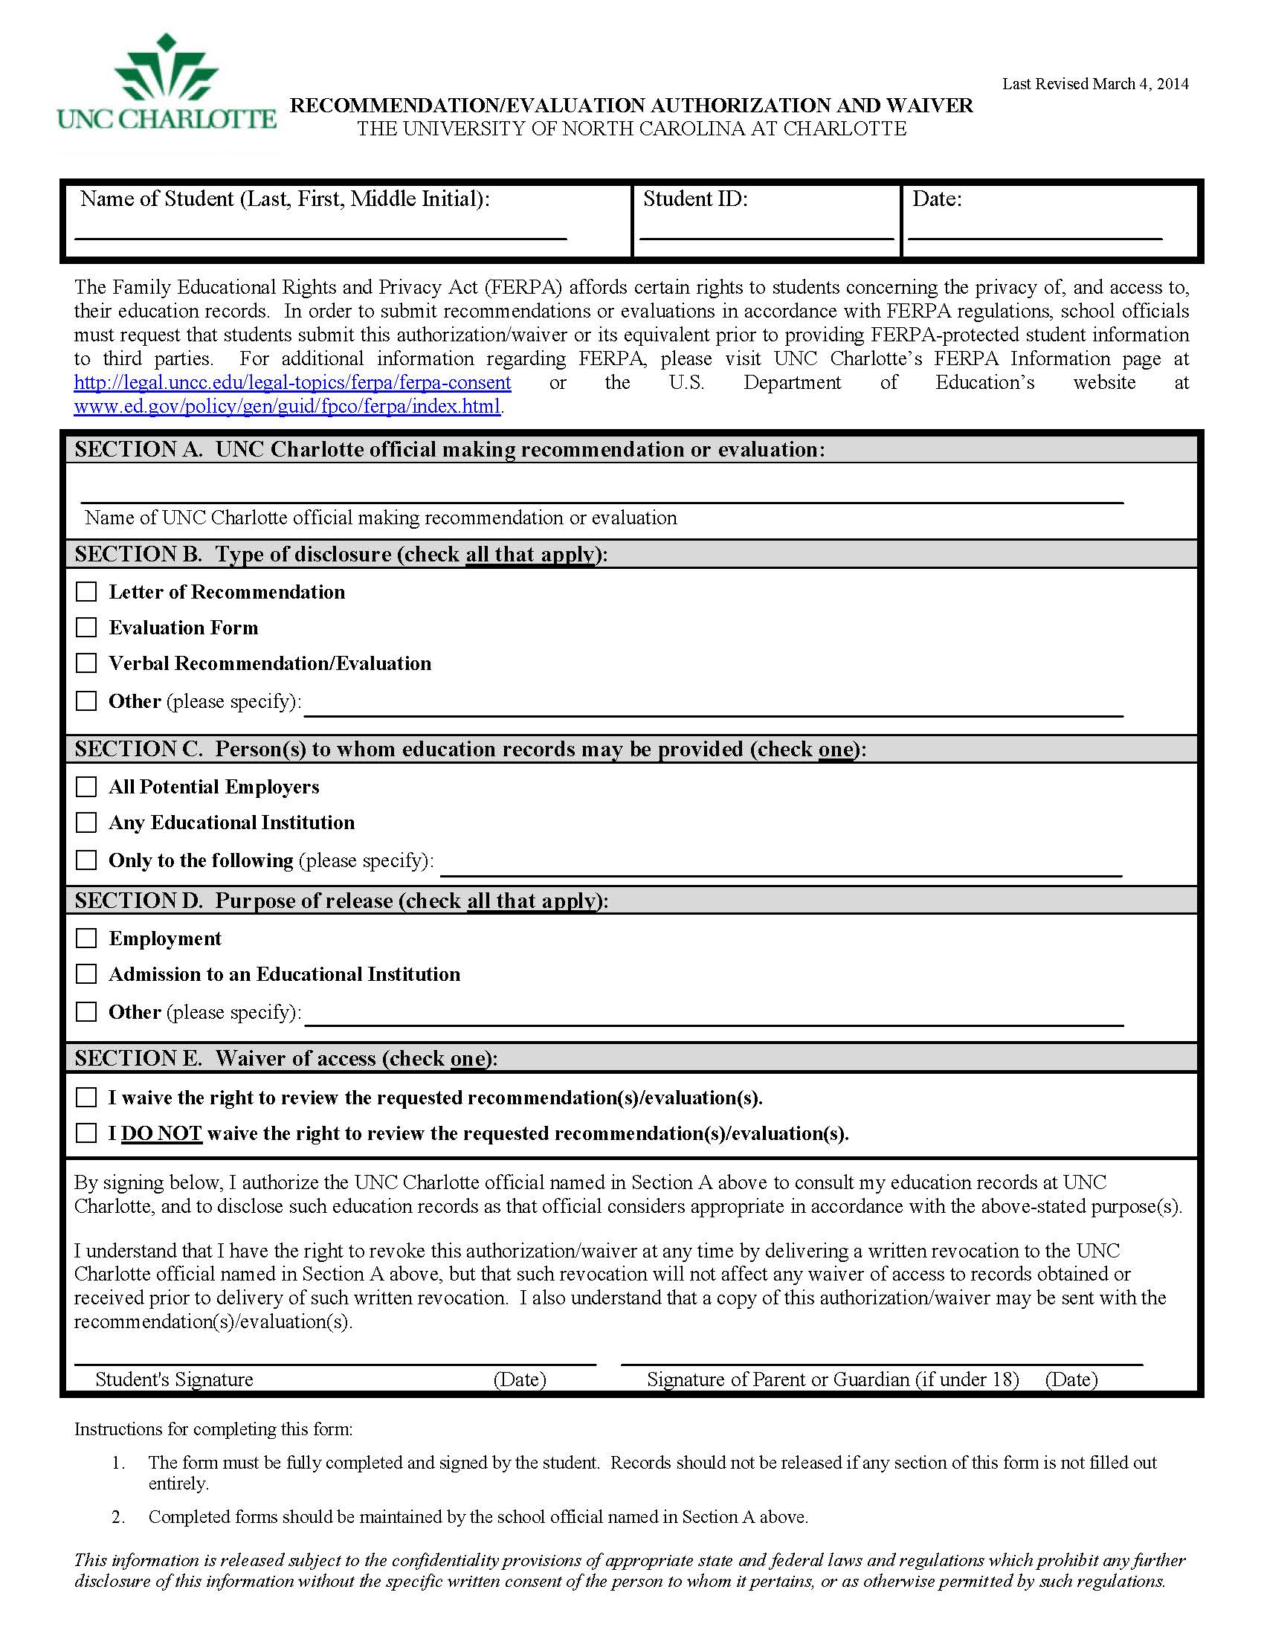
On Legal Affairs FERPA page
Student must complete form before you can provide recommendation

Slide 18
Letters of Recommendation
With written consent:
  Permitted to disclose information from education records
    to person/entity specified on consent form
    for the purpose specified on consent form
  Remember that if waiver box is not checked, student has right to access the recommendation you write about him/her

Slide 19
Parents
FERPA rights belong to student, not parents
Some ways by which parents can receive information from education records
  With student’s written consent;
  If student is dependent for tax purposes;
  In a health or safety emergency; or
  If the information is based on personal knowledge or observation of student, not based on protected record information

Slide 20
Parents (cont.)
Some parents can be good influences to help student succeed, so don’t automatically cut off communications for fear of FERPA
However, if conversation gets difficult or unproductive, you can end it
  Signed consent form permits (but does not require) you to talk with parents
If FERPA vs. health/safety of student, always err on side of health/safety
“Proxy” system in development

Slide 21
Examples
A concerned father calls and shares their student is diagnosed with depression. He asks that you check on the student and let them know how his child is doing both in class and outside of class. What should you do? What can you share?
A parent calls and wants to know why you aren’t following a specified university process. You know the student well and have helped on multiple occasions, but the student is unresponsive and doesn’t follow through with what she needs to do in order to allow the process to move forward. What do you tell the parent?
Honor Society writes dean and asks for names and addresses of all students in college majoring in Biology and who have achieved 3.0 average.
Disclosure to parents/third parties when student is present.
You have a valid written consent from a student to release her information, but in your judgment, you don’t think it’s in the student’s best interest to make the release.
Leaving student information on desk or computer screen.

Slide 22
Examples (cont.)
Woman says, “I am X’s wife and he asked me to pick up his transcript.”
  What if she has a written note from the husband/student authorizing delivery to his wife ?
FBI agent presents badge and says that he is investigating a crime and it is of the utmost urgency that he see student’s records immediately.
Two students are accused of cheating off of each other during an exam after a third student reports the behavior. One of the accused students requests to inspect any emails related to the situation.

Slide 23

Questions?

Slide 24
Office of Legal Affairs website on FERPA
  https://legal.uncc.edu/legal-topics/ferpa
My email address
jesh.humphrey@uncc.edu

