Slide 1

Policies, Policies, Policies!
What are they? Why are they important?
How do I develop new ones or revise old ones?
Office of Legal Affairs
Fall Symposium
October 15, 2015

Slide 2
Presented by…
Amy S. Kelso
  Senior Associate General Counsel, Office of Legal Affairs
  Phone: 828-232-4990, Email: amy.kelso@uncc.edu
Tina Dadio
  Paralegal and University Public Records Officer, Office of Legal Affairs
  Phone: 704-687-5732, Email: t.dadio@uncc.edu

Slide 3
Overview
This session will provide:
Explanation of what University Policies are, and why they are important
Overview of the new-ish “policy on policies,” University Policy 805, University Policy Development, Approval, and Publication (March 24, 2015)
Review of the procedures for development, review, revision, approval, and publication of University Policies

Slide 4
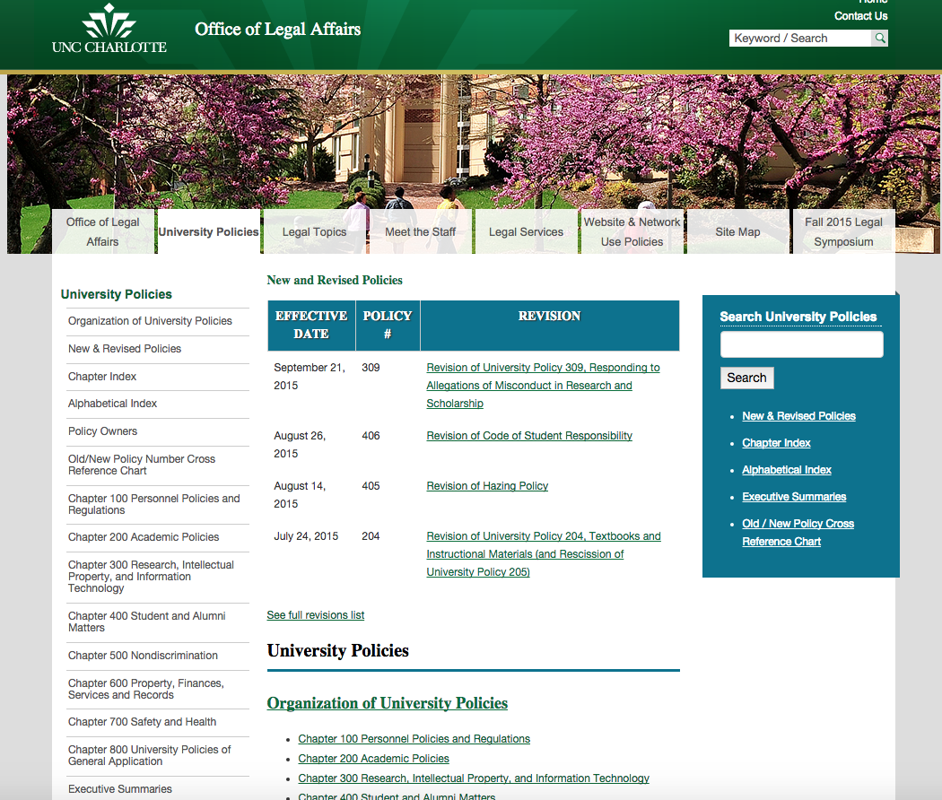
University Policies Website legal.uncc.edu/policies

Slide 5
What is a University Policy?
A University Policy is a written statement of policy of general applicability to members of the University community.
Developed by a college, department, or unit or by University administration
Declares institutional principles and standards
Establishes definitions
Assigns responsibility
Prescribes behavior and consequences
Establishes procedures

Slide 6
What is NOT a University Policy?
University Policies do not include college/departmental policies, which
  apply only to the operation of a specific college, department, or unit,
  promote operational efficiencies or enhance the mission of the college, department, or unit, but are not broadly applicable throughout the University, and
  may supplement, but must not conflict with, University Policies.

Slide 7
Why do we need University Policies?
University Policies contribute to institutional stability by:
Enhancing the University’s mission
Informing and educate the University community
Providing clarity and guidance to the University community
Setting standards for community behaviors
Promoting operational efficiencies
Establishing responsibilities and accountability
Requiring consistency in application
Ensuring coordinated compliance with external laws, regulations, and policies
Reducing institutional risk

Slide 8
University Policy 805, it’s sort of meta…
University Policy 805, University Policy Development, Approval, and Publication, is UNC Charlotte’s new “policy on policies” (March 2015)
Purpose of UP-805 is to ensure consistency and clarity regarding development, review, revision, approval, and publication of University Policies.
Requires that University Policies be current, consistent, and available to all who are expected to comply with them.

Slide 9
Supplemental Procedures or Regulations
Appended to some University Policies, they:
contain specific mechanisms or processes related to a University Policy,
establish how that University Policy should be carried out, and
may include detailed instructions, steps, and/or forms that facilitate compliance with a University Policy.
Not all University Policies include Supplemental Procedures or Regulations.

Slide 10
Roles and Responsibilities
Office of Legal Affairs
Manages the process for development, approval, and publication of all University Policies
Ensures that University Policies are consistent with applicable laws, regulations, and governing policies
Determines who has approval authority for each University Policy, according to applicable laws, regulations, and related policies
Determines whether a proposed policy follows the requirements for a University Policy

Slide 11
Roles and Responsibilities
Responsible Office/Policy Owner
Owns, develops, and administers a particular University Policy and Supplemental Procedures or Regulations, if any
Accountable for the accuracy of the subject matter, as well as timely review and updating
Responsible for following the procedures and standards of UP-805
Ensures that its University Policies are consistent with other policies within its area, communicated properly, reviewed regularly, revised or updated as needed, and monitored for compliance and effectiveness.
Chart of Policy Owners for each University Policy: legal.uncc.edu/policy-owners

Slide 12
Roles and Responsibilities
Chancellor’s Cabinet
responsible for reviewing and recommending the approval or revision of University Policies.
Chancellor
responsible for final approval of University Policies over which he or she has authority, such authority being determined by governing policies or regulations
Board of Trustees
responsible for final approval of University Policies over which it has authority, such authority being determined by governing policies or regulations

Slide 13
Standards
Policy Standards
Clear and concise
Contain sufficient information on the subject without being excessive in length
Detailed mechanisms or processes in Supplemental Procedures, Supplemental Regulations, or departmental policies
Standard Format
Policy Title
Policy Statement and Purpose
Definitions
Applicability
Procedures
Roles and Responsibilities
List Revision History (including the initial effective date and all revision dates); Authority (Chancellor or Board of Trustees); Responsible Office/Policy Owner; Related Resources

Slide 14
Approval Exceptions
Clerical Changes
Some clerical or non-substantive revisions to existing University Policies may be approved by the Responsible Office and the Office of Legal Affairs without full review and recommendation by the Chancellor’s Cabinet.
Supplemental Procedures or Regulations
May initially be developed, revised, and approved as part of the approval of a new or revised UP, but may also be revised or updated without additional review and approval of the Chancellor or BOT, in the discretion of the Office of Legal Affairs and/or the Chancellor.
Interim Policies (slide 15)
Rescission (slide 16)

Slide 15
Interim Policies
Chancellor may issue Interim University Policies without full review and recommendation, under exceptional circumstances:
  need to expedite the issuance of a University Policy because of external compliance deadlines;
  developments that will, or could, significantly affect the safety or welfare of members of the campus community; or
  where the step is necessary or desirable to facilitate orderly and efficient campus operations.
Interim University Policies generally in effect for no more than six months
Responsible Office/Policy Owner should initiate process for review and approval of a final University Policy promptly

Slide 16
Policy Rescission
Rescinding a University Policy is necessary whenever the policy:
has become inconsistent with legal or policy requirements;
no longer reflects the University’s practice; or
when the policy is consolidated into other policies.
Only the authority that originally approved a University Policy is authorized to rescind that policy (Chancellor or BOT).

Slide 17
Policy Publication
All approved University Policies, Interim Policies and Supplemental Procedures or Regulations will be published on the official University Policy site of the University (legal.uncc.edu/policies).
If a unit wishes to include University Policies on its website, it must do so by means of a link to the official University Policy site to assure that the official version is referenced.
The official University Policy site will be the only site that carries the assurance that the University Policies posted on it are current and correct.

Slide 18
Policy Review
Every University Policy will be reviewed at least every five years by the Responsible Office for that policy, or more frequently, if necessary.
Responsible Office will propose revisions or updates on an as-needed basis to keep the Policy current and whenever necessary to comply with regulatory changes or changes in business operations.
Office of Legal Affairs will oversee the review/revision process (see following slides). Policy modifications will follow the same review and approval process as for new University Policies.

Slide 19
Policy Development/Revision Flow Chart
New policy or revision is requested or developed by
Chancellor or Cabinet member/designee and sent to OLA
OLA works with policy owner to assist in drafting revisions or new policy
Once finalized, OLA emails to Chancellor and Cabinet members for review
OLA collects feedback from Cabinet members/designees
OLA works with responsible office/owner to draft any additional revisions
Policy placed on Cabinet agenda for discussion
Cabinet discusses & recommends for approval or sends back for further revision
OLA sends to Chancellor or BOT (if required)
for approval
Policy posted on OLA website, notice sent to Cabinet for dissemination,
OLA maintains digital copy of the expired policy

Slide 20
Policy Revision/Development Process legal.uncc.edu/sites/legal.uncc.edu/files/media/UP-805-Procedures.pdf
Step 1
New policy or revision requests must be initiated by Chancellor or a Chancellor’s Cabinet member or designee
Requests must be sent to the Office of Legal Affairs (OLA)
Step 2
  OLA reviews new policy draft or revision
  OLA works with requestor/Policy Owner to develop draft of the new policy or revision
  OLA makes recommendations as to form, format, clarity, substance, and legal implications

Slide 21
Policy Revision/Development Process
Step 3
Once revision/drafting process is complete, OLA determines that draft is in good legal form
OLA emails to Chancellor and Cabinet members:
  New policy draft or redlined version of revised policy
  Explanatory memo
OLA sets a deadline for comments
Step 4
OLA collects comments/recommendations from Chancellor, Cabinet members/designees
OLA works with requestor/Policy Owner on additional revisions

Slide 22
Policy Revision/Development Process
Step 5
  Once policy finalized, it is placed on Cabinet meeting agenda:
    3 weeks time, if no revisions
    follow-up Cabinet meeting, if necessary
    additional Cabinet meetings, if inability to resolve issues
Step 6
  If under Step 5, Chancellor determines further editing/revisions, OLA will:
    work with unit/Policy Owner to draft revisions
    re-submit revised draft for Cabinet review or solely to Chancellor, if so requested
    step 6 will repeat, if necessary, until policy approved

Slide 23
Policy Revision/Development Process
Step 7
If Chancellor authorized to approve, OLA produces an approval letter for Chancellor’s signature, along with final draft (approval process complete)
If BOT authorized to approve, it’s placed on BOT agenda for next regular meeting, along with resolution and memo and final draft, if approved (process complete)
Step 8
Once final approval complete, OLA will:
  post new policy on OLA website
  create revision page for policy under “Recent Revisions” web page
  Submit announcement to Inside UNC Charlotte for publication
  Notify Policy Owner and Cabinet Members and request that they disseminate the new/revised policy to their units, as appropriate.

Slide 24
Policy Revision/Development Process
Step 9 – FINAL
OLA maintains a digital copy of the expired version of the policy in its archive files

Slide 25
Questions?
Amy S. Kelso
  Senior Associate General Counsel, Office of Legal Affairs
  Phone: 828-232-4990, Email: amy.kelso@uncc.edu
Tina Dadio
  Paralegal and University Public Records Officer, Office of Legal Affairs
  Phone: 704-687-5732, Email: t.dadio@uncc.edu

