Slide 1


The Intersection between
Public Records Act and State Human Resources Act
Connecting the dots…
Tina Dadio, University Public Records Officer/Paralegal
Fall 2015 Legal Symposium
October 15, 2015
Office of Legal Affairs

Slide 2

All documents of any type “regardless of physical form or characteristics…made or received in connection with the transaction of public business by any agency of North Carolina”.
- Note: Basically, all records created or received in the course of university business in whatever format is considered a public record.
North Carolina Public
Records Act
NCGS §132-1 et seq.

Slide 3
Whatever format…regardless of location
FORMAT:
  Papers, letters, maps, books, photographs, films, sound recordings, e-mail, text messages, voice mail messages, etc.
PHYSICAL LOCATION
  Records on your personal devices (computers, smart phones, iPad, etc.)
Note: The status of a record under the law is determined based on its content, not its location…

Slide 4

What is the State Human Resources Act?
“It defines the broad set of laws related to employment of state workers in North Carolina and creates an appointed commission to make other personnel rules as needed.”
Note: Personnel records are confidential under the North Carolina Human Records Act, but certain information about each employee is open to public inspection under NCGS §126-23.

Slide 5
PERSONNEL FILE
North Carolina State Human Resources Act defines a “personnel file” as “any employment related or personal information gathered by the University as an employer.”
North Carolina State
Human Resources Act
NCGS §126-1 et seq.

Slide 6
Employment-related information:
- Individual’s application, selection, promotion, demotion, transfer, leave, salary, contract for employment benefits, suspension, performance evaluation, disciplinary actions, and termination.
Personal information:
- Individual’s home address, social security number, medical history, personal financial data, marital status, dependents, and beneficiary.
PERSONNEL FILE

Slide 7

What’s public in my personnel file?
Name
Date of original employment/appointment
Department
Current title
Age (not date of birth)
Terms of any contract
Current position
Current salary
A few other exceptions…

Slide 8
Personnel Information…Public
Date and amount of each increase or decrease in salary
Date and type of each promotion, demotion, transfer, suspension, separation, or other change in position classification
General description of the reasons for each promotion
Date and type of each dismissal, suspension, or demotion for disciplinary reasons. If the disciplinary action was a dismissal, a copy of the written notice of the final decision of the head of that department setting forth the specific acts or omissions
that are the basis of the dismissal.

Slide 9
Does an employee have access to his/her personnel file?
Yes. An employee may examine his/her entire personnel file with these exceptions….
  Letters of reference solicited prior to initial employment
  Information concerning medical disabilities (mental or physical) that a physician might not have disclosed to the employee.
  Note: Originals may not be borrowed and must be maintained in the file.

Slide 10
What about search committee notes?
Generally, all applicants may request to have access to data about themselves that is collected, maintained, or created in the search process, including HANDWRITTEN NOTES.
Important that the records and notes you make reflect ONLY job-related information.
When search is closed, forward all search committee notes to:
  Faculty positions go to Academic Affairs
  Non-faculty positions go to Office of Human Resources
NOTE: Search committee notes are subject to the North Carolina Public Records Act (but not generally
discloseable).

Slide 11
Search committee notes: What you need to know…
Reflect only job-related information to be used in evaluation process, such as:
  Information relating to the candidate’s technical and educational background
  BE CAREFUL how comments are phrased to avoid any MISPERCEPTIONS

Slide 12
University Policy 501 Nondiscrimination and Procedure for Addressing Reports of Discrimination
The University of North Carolina at Charlotte affirms that its educational and employment decisions must be based on the abilities and qualifications of individuals and may not be based on irrelevant factors, including personal characteristics, that have no connection with academic abilities or job performance. The following factors may not form the basis for educational or employment-related decisions:
race
color
religion
sex
sexual orientation
political affiliation
actual or perceived gender identity
age
national origin
physical or mental disability
veteran status
genetic information

Slide 13

SEARCH COMMITTEE NOTES
DO’S AND DON’TS
http://www.personalbrandingblog.com/eliminating-age-discrimination/

Slide 14
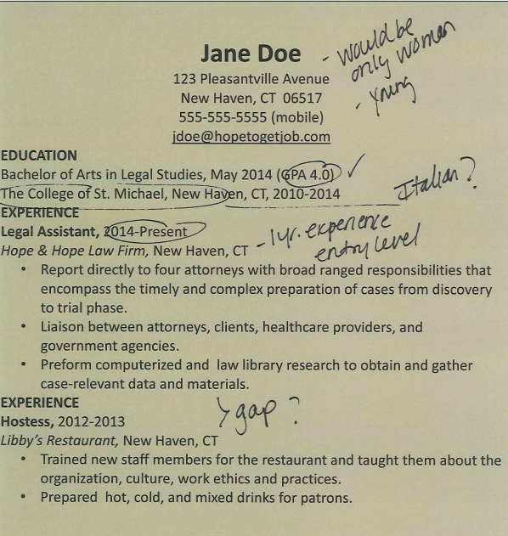
Don’t make reference to age or gender
Don’t refer to any religious affiliation or ethnic group
Okay to reference GPA
Okay to note years of experience
Okay to note gap, but be careful how you phrase your question

Slide 15
Your Duty to Retain Records
When search is closed, forward all search committee notes about the selected applicant to Academic Affairs (faculty positions) or Human Resources (non-faculty positions)
Search committee notes about all other applicants should remain in the applicable department for three (3) years, according to our University Policy 605.3, Retention, Disposition, and Security of University Records.
Any records that are not part of the official record should be destroyed when they are no longer needed, unless there has been a request for that information.

Slide 16
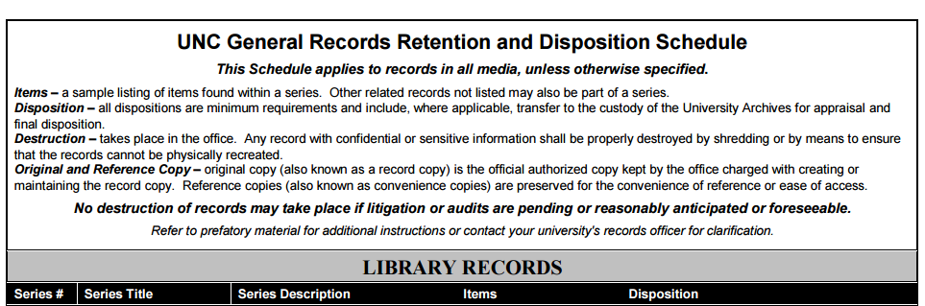
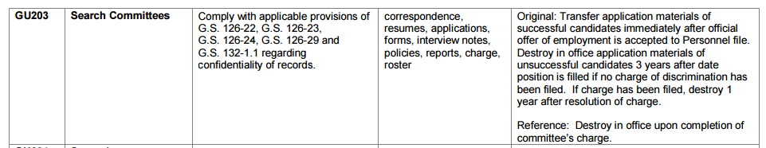
http://legal.uncc.edu/sites/legal.uncc.edu/files/media/UNCGeneralSchedule.pdf

Slide 17
WHAT ABOUT EMAIL COMMUNICATIONS?
Email can be a public record, if it is made or received by a state employee in connection with State business.
The status of a record under the law is determined based on its CONTENT, not its location
Records in “whatever format…regardless of location” shielded and generally not discloseable are:
  “. . . information [which] relates to the individual's application, selection or nonselection, promotions, demotions, transfers, leave, salary, suspension, performance evaluation forms, disciplinary actions, and determination of employment…” EXCEPT THOSE ITEMS SUBJECT TO
  N.C.G.S.§126-23(a)1-12.

Slide 18
BEST PRACTICES
Don’t write notes or make references that have no bearing on the job-related qualifications.
  Do take clear, job-related, fact-based notes.
Don’t write or email anything that you wouldn’t wish to be made public.
    Do write or email based on job duties and qualifications
Avoid usually indefensible screening criteria (race, gender, color, gaps in employment, etc.)
  Do use the same criteria and questions for each applicant interview.

Slide 19
RECAP AND TAKEAWAYS
Remember CONTENT matters not format or location
Emails can be a public record
Treat email communications the same way you would a letter
Avoid using personal resources, including private email accounts,
for public business
All notes become part of the official record
Casual comments noted in margins can be evidence of discriminatory evaluations
IF IT’S MADE OR RECEIVED IN CONNECTION WITH PUBLIC BUSINESS AT THE UNIVERSITY
IT’S PUBLIC!

Slide 20

QUESTIONS…

