Slide 1

Supplies, Equipment, and Services
How to purchase, insure, and account for them
Office of Legal Affairs
Fall Symposium
October 15, 2015

Slide 2
Panel Members
Scott Brechtel
  Purchasing Manager, Materials Management
  Phone: 704-687-7329, Email: sjbrecht@uncc.edu
Greg Verret
  Assistant Controller-Compliance, Controller’s Office
  Phone: 704-687-5782, Email: gverret@uncc.edu
Sally K. Peterson, AINS
  Risk Analyst, Office of Risk Management and Insurance
  Phone: 704-687-5711, Email: speterson@uncc.edu
Amy S. Kelso
  Senior Associate General Counsel, Office of Legal Affairs
  Phone: 828-232-4990, Email: amy.kelso@uncc.edu

Slide 3
Introduction
This session will provide a broad overview of the process for purchasing commodities (supplies and equipment) and services on behalf of the University, including:
  basic contracting and insurance requirements,
  liability,
  mitigation of risk,
  state rules and benchmarks for procurement, and
  basic framework for recording the purchases in fixed assets.

Slide 4
Purchasing
Purchasing rules in North Carolina are classified under General Statutes §143-48 through §143-59
UNC Charlotte has delegated authority from state Purchase & Contract and must follow their rules
  University delegation is $500,000
  Purchasing rules applied regardless of fund source
  Competition is required once the bidding threshold is reached
  UNC Charlotte Purchasing Manual sections 2.4 and 2.5 address bidding rules
  The state sets the rules that UNC Charlotte must follow and they are applied to all purchases

Slide 5
Purchasing
Procuring goods and services for the University
49er Mart is the one stop shop for day to day purchasing needs
  Commodity purchases
    Punch-out catalogs
    Hosted catalogs
    Non-catalog items
  Services—General Services Form
    Multi Invoice Service Orders
  After the Fact requests
  Pre-payments allowed on a case by case basis
  Freight charges paid up to $50 OR if a note is added by department
  Tolerance for invoices is the lesser of 10% or $50
  Changes and returns
Purchasing Card
Direct Pay Request

Slide 6
Purchasing
State Competitive bidding requirements
Competition is required once the bidding threshold is reached
Solicitations are required if a single purchase exceeds $5,000 or the cumulative spent with a single vendor for like commodities or services exceeds $5,000 over the course of the fiscal year
Procurements up to $25,000 can be informally conducted by collecting at least three competing quotes
Once the $25,000 threshold is reached, formal bidding is required and must be posted to the Interactive Purchasing System (IPS)
Competition requirements may be waived on a case by case basis
  Waiver of Competition justification from the department must be submitted to Purchasing
  Requests may NOT be split to avoid bidding requirements

Slide 7
Purchasing
Competitive bidding continued
Purchasing Office coordinates the formal solicitation process
  Department provides specifications or scope of work
  Suppliers should NOT write your specifications
  Specifications cannot be too limiting or competition will not be possible
  An IFB is conducted to secure prices for known items
    Award made to lowest bidder meeting specifications
  An RFP is conducted when we know the needed result but ask vendors to propose overall best value process solutions
    Award made to the highest scoring firm on the evaluation representing the overall best value

Slide 8
Purchasing & Contracts
Contracts for Goods or Services
Contracts are required every time the University engages with a company or an individual
  State’s competition rules still apply
  Establishing the document protects both parties by defining the scope, terms, and liabilities
Must be signed by both parties
Review required to ensure compliance with North Carolina law
Purchasing Office is the first stop for contract review and negotiation
Legal Affairs brought in for clarifications or difficult negotiations

Slide 9
Purchasing & Contracts
Contracts for Goods or Services continued
Purchasing Office will review and negotiate contracts provided to departments by Contractors
Purchasing will also verify we have a copy of the Contractor’s liability insurance on file
  Templates available on the Purchasing website
    Contract Document
    Personal Services Agreement
  Individuals also require an Independent Contractor Checklist
  Special rules govern Consultants

Slide 10
Purchasing & Contracts
Contracts for Goods or Services
Require proper signature authority
  University Policy 603.1, Authority to Sign Contracts and Other Official Documents
Review using Contract Checklist: legal.uncc.edu/legal-topics/contracts/contract-checklist
Contracts to obtain the services of consultants
  Always discuss any contract to obtain goods or services with Purchasing
Contracting resources on Office of Legal Affairs website: legal.uncc.edu/legal-topics/contracts

Slide 11
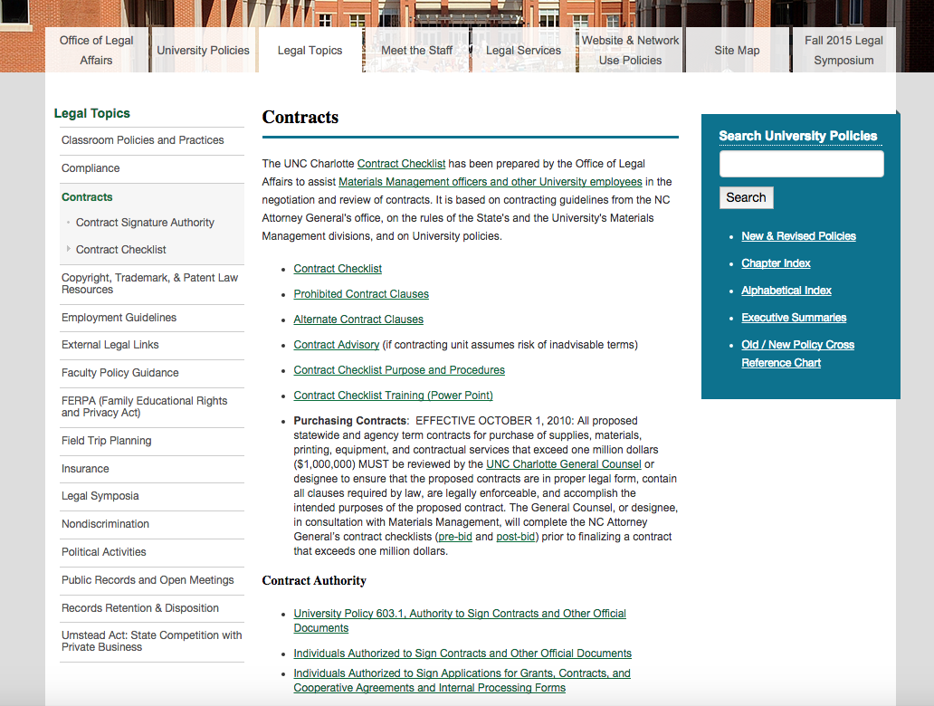
Contracting Resources
legal.uncc.edu/legal-topics/contracts

Slide 12
Purchasing
Structure of the Purchasing Office
Director of Materials Management
  Signature authority to sign many contracts
Assistant Director/Purchasing Manager
  Staff of five Purchasing Agents
    Departmental assignments available on our website
  Purchasing 101 and 201 offered twice annually
  Always feel free to call or email with questions
    Purchasing@uncc.edu

Slide 13
Property Insurance
Most all business personal property/contents is insured with the State Property Fire Insurance Fund
Deductible is $5,000, but value of purchased item should likely be included in building’s total contents
Perils: Fire, Lightning, Windstorm, Hail, Explosion, Aircraft or Vehicles, Riot or Civil Commotion, Smoke
Special Computer Coverage is available with expanded perils included
Contact Risk Management for assessment

Slide 14
Means of Handling Liability
Avoidance
Mitigation
Transfer via contract – defense & indemnity
Transfer via insurance

Slide 15
Liability Insurance – Products & Services
Protection against financial loss due to bodily injury to our people or damage to our property as a result of activities from outside service entities or purchased products coming onto UNCC’s campus

Slide 16
What Kind of Risks?
Standard Risk
Low Risk
High Risk
Specialty
Low risk service/repair
Landscaping
Discussion Leader
Appraiser
Appliance repair
Product defects
Electric/Elevator maintenance
Painting
Concrete Work
Road Contractor
Architects and Consultants
Sewer Contractor
Power Lines
Welding
Medical Services
Construction Services
Environmental Hazards
Demolition

Slide 17
Sovereign Immunity
State (NC) is immune from all lawsuits, either monetary or injunctive relief unless negligence is proven
State universities considered state agencies
State agency cannot waive the State's sovereign immunity and assume liability for actions not covered by the Tort Claims Act for an amount greater than allowed under the Tort Claims Act ($1,000,000), or for liabilities different from the liabilities allowed under the Tort Claims Act (such as attorney's fees)
Tort Claims Act allows parties to bring a claim against the State or its employees for limited relief.
  Must prove a State employee negligent
We want to avoid the Tort Claims process
Solution – Transfer liability to parties with whom we do business
Associated entities may not be State Agencies

Slide 18
Insurance Requirements
General Liability – additional insured
Professional Liability – consider
  Required for professional services such as attorney, accountant, doctor, architect, engineer, etc.
Automobile Liability – additional insured
Workers’ Compensation
  Required if contractor/vendor will have employees working on campus or at our satellite locations

Slide 19
Questions to consider when making a purchase or hiring outside service
What activity will take place?
Who could be harmed?
Are crowds/bystanders likely to be involved?
What property could be damaged and how severely?
What is the worst case scenario for the activity?
How likely is the organization to be a defendant in the event of a loss?
What is the cost and duration of the work?

Slide 20
Fixed Assets
What is a “fixed asset”?
University property such as land, buildings, and equipment, with a total cost equal to or greater than $5,000 and a useful life of two or more years.
  Exception: Software must be >$100,000
  “Total costs” = purchase price + other costs incurred to place the asset in its location and condition for use (e.g., shipping, installation, set-up fees)
    Does NOT include service contracts or extended warranties
    Maintenance contracts NOT included; do not extended useful life of asset

Slide 21
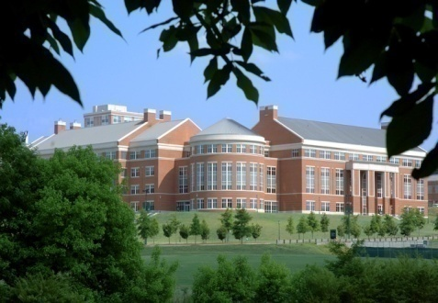
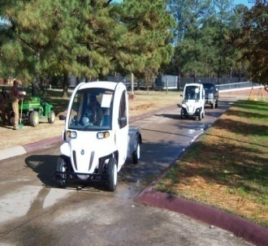

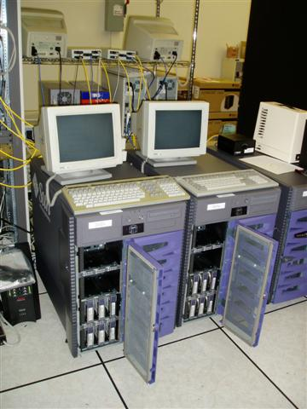
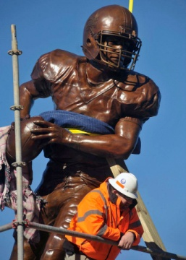
Examples of Fixed Assets
Buildings
Infrastructure
Art Collections
Campus Vehicles
Equipment

Slide 22
Fixed Assets, By Type

Slide 23
Fixed Assets Policies
University Policy 601.15, Control and Management of University Equipment & Other Property
legal.uncc.edu/policies/up-601.15 (formerly policy # 79)
Highlights:
  Fixed assets definitions
  Responsibilities for each level of staff involved with fixed assets
  Obligated to comply with fixed assets procedures
Supplemental Procedures to Policy #601.15 highlights:
  Requirements during Annual Inventory
  Process for lost and stolen assets

Slide 24
Acquisition of Fixed Assets
The Fixed Asset Office is a reviewer on all 49erMart purchases that exceed $5,000 and/or use Fixed Asset account codes
Once a fixed asset item is received and paid, an inventory tag is assigned
Inventory Control will physically tag the asset, and also obtain other key information that will be recorded:
  Name of asset custodian
  Location of asset
  Make, serial number, model number, and other info

Slide 25
Inventory Verification Process
Inventory verification conducted throughout the year
Fixed Assets will notify department liaison requesting inventory list
Must complete within 6 weeks
Inventory Control will coordinate to physically verify department’s assets
Custodian is responsible for making all assets available to Inventory Control
After physical inventory, Inventory Control returns updated list to Fixed Assets
Fixed Assets will send the updated list for Department Head to sign and return within 10 business days.

Slide 26
Inventory Best Practices
Notify Fixed Assets of any changes in status of department assets as they occur (e.g., stolen, lost, location change, missing/defaced tag, transfers, surplus, or traded-in)
Check your assets listed before Inventory Control comes to verify them
Track laptops at departmental level
Key contacts for additional questions:
  Karen Worthy, Fixed Assets Accounting Technician, 7-5754
  John Cashion, Inventory Control-Stock Supervisor, 7-0374

Slide 27
Questions?

