Slide 1
DIVISION OF INSTITUTIONAL INTEGRITY
LEGAL SYMPOSIUM
OCTOBER 16, 2018
5-4: How Brett Kavanaugh’s Supreme Court Appointment Might Affect UNC Charlotte

Slide 2

SCOTUS Eras
Dean Chemerinsky believes we’ve entered into a new “era” of the Supreme Court:
  1890s to mid-1930s (very conservative Supreme Court)
  1937 to 1969 (progressively more liberal court, particularly in 1960s under Earl Warren)
  1971 to today (beginning with Nixon’s appointees, always at least five idealogically conservative, Republican-appointed justices, but with a “swing justice” to effect a liberal result in high-profile cases)
Notes:
-1890s to mid-1930s court declared unconstitutional over 200 federal, state, and local laws that were designed to protect workers and consumers.
-Warren court, in particular, expanded liberties such as voting and privacy, and protected the rights of criminal defendants.

Slide 3
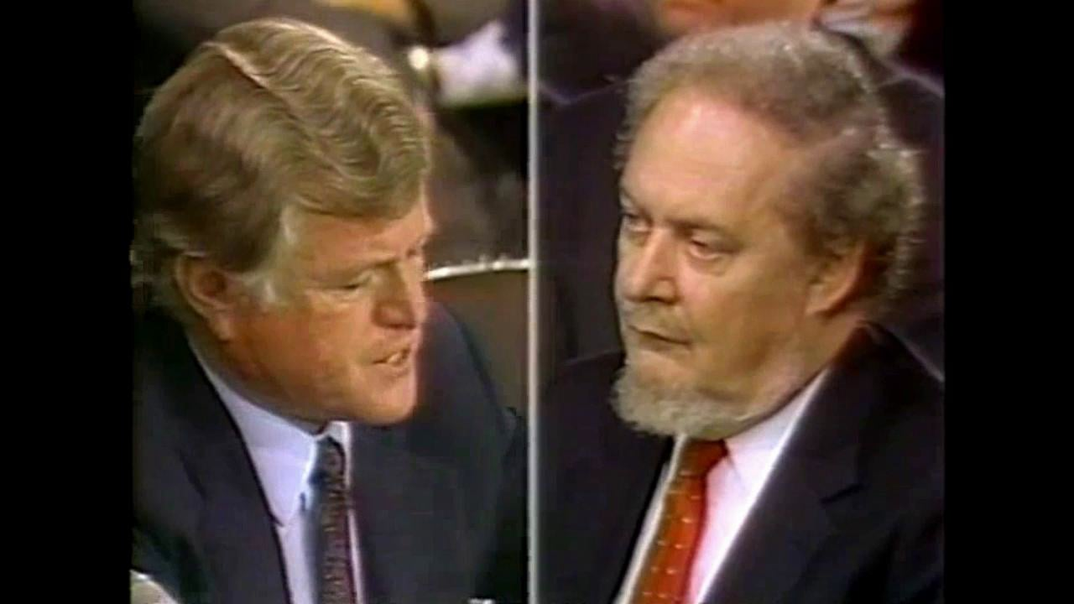
Kennedy’s Appointment
Reagan appointee (1988) following two unsuccessful nominations (Bork, Ginsburg) and extremely thorough background check
Approved unanimously by Senate (97-0)
Notes:
-Bork became a verb after he was voted down by a Democratic coalition who asserted he was an extreme ideologist who would roll back civil rights protections and advocated for executive supremecy. Opposed by ACLU, along with Rehnquist, Alito, and Kavanaugh.
-Douglas Ginsburg withdrew after NPR’s Nina Totenberg revealed he had used marijuana in the 60s and 70s; no relation to RBG. Remember this was set against backdrop of Nancy Reagan’s war on drugs and the “Just Say No” campaign
-last unanimous vote for SCOTUS appointee (RBG: 96-3 in 1993, Jesse Helms was one of the dissenters)
-Kennedy came from 9th Circuit Court of Appeals

Slide 4
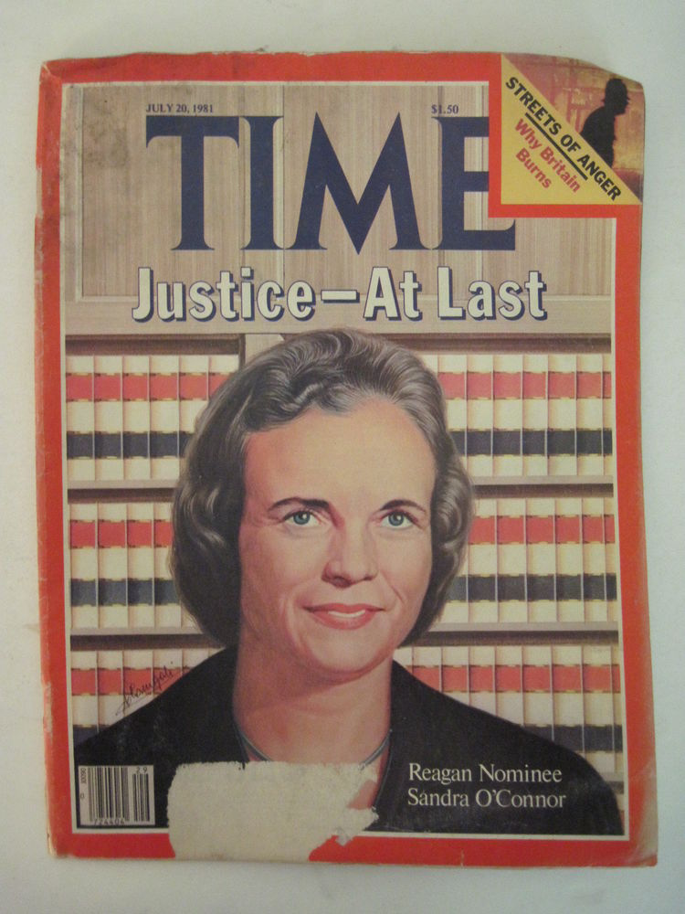
Kennedy: The Early Years
Until her retirement in 2005, Sandra Day O’Connor was viewed as the swing vote on the Court:
  Planned Parenthood v. Casey (1992): broke with Chief Justice Rehnquist and in affirming Roe v. Wade (Kennedy co-authored opinion)
  Lee v. Weisman (1992): finding that government-sponsored prayer is not permitted at high school graduations (Kennedy authored opinion)
  Stenberg v. Carhart (2000): overturned a Nebraska ban on “partial-birth” abortions (Kennedy dissenting)
  Grutter/Gratz v. Bollinger cases (2003): affirmed, but limited, the right of state colleges and universities to use affirmative action in admissions policies (Kennedy in majority for Gratz, dissented from Grutter)

Slide 5
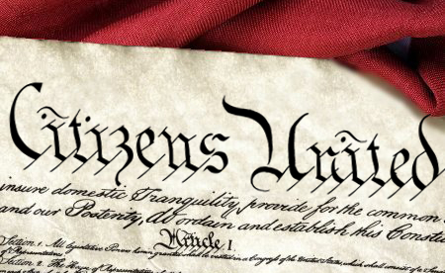
Kennedy: The Conservative
Justice Kennedy has been solidly with conservative justices with respect to several issues:
  Campaign finance
  Church and state (accommodationist view)
  Business (free speech, environmental issues, favoring arbitration over adjudication)
  Executive authority

Slide 6
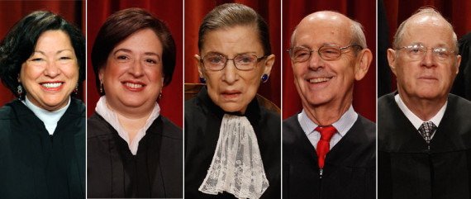
Kennedy: The Liberal
On other issues, however, Kennedy has sided with the SCOTUS’s liberal bloc:
  Affirmative action
  Gay rights
  Abortion rights

Slide 7
Kavanaugh v. Kennedy: Affirmative Action
Metro Broadcasting (1990)/Adarand Constructors (1995): 5-4 cases in which Kennedy vehemently argued against lower standard of judicial review for race-based affirmative action
Grutter v. Bollinger (2013): 5-4 case, Kennedy in minority
Gratz v. Bollinger (2013): 5-4 case, Kennedy in majority
Fisher v. Texas I (2013): Kennedy wrote 7-1 majority opinion
Fisher v. Texas II (2014): Kennedy wrote 4-3 majority opinion, joined liberal justices
Current issues:
  Is promoting diversity (and avoiding racial isolation) a compelling state interest?
  Parents Involved in Community Schools v. Seattle School District No. 1 (2007): 4-1-4 decision, with Kennedy as the “1” reiterating that compelling interests exist in avoiding racial isolation and promoting diversity
    Roberts quote: “The way to stop discrimination on the basis of race is to stop discriminating on the basis of race.”
PREDICTION:
  Nothing on docket for next term, but eventually colleges and universities will be colorblind with respect to admission
Notes:
-Parents Involved case: At issue were efforts for voluntary school desegregation and integration in Seattle, Washington, and Louisville, Kentucky. Both school districts voluntarily used individualized racial classifications to achieve diversity and/or to avoid racial isolation through student assignment. The Court recognized that seeking diversity and avoiding racial isolation are compelling state interests, but struck down both school districts' assignment plans, finding that the plans were not sufficiently "narrowly tailored," a legal term that essentially suggests that the means or method being employed (in this case, a student assignment plan based on individualized racial classifications) is closely and narrowly tied to the ends (the stated goals of achieving diversity and/or avoiding racial isolation).
-Kavanaugh has not had any race cases, but once predicted in an op-ed for the WSJ that SCOTUS would eventually find that “in the eyes of government, we are just one race.”

Slide 8
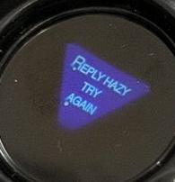
Kavanaugh v. Kennedy: Gay Rights
Obergefell v. Hodges (2015): 5-4, four scathing dissents, only dissent ever read from the bench by John Roberts
United States v. Windsor (2013): 5-4 federal Defense of Marriage Act case (for purpose of federal benefits, marriage is between a man and a woman)
Pavan v. Smith (2017): per curiam decision with Gorsuch, Alito, and Thomas dissenting (*note* no Roberts), Arkansas law re: birth certificates
Current issues:
  Circuit splits as to whether Title VII protects against discrimination for sexual orientation
  Unclear whether Title IX addresses discrimination against transgender students
  Masterpiece Cakeshop (2018): 6-3, Kennedy-authored opinion, intersection of Free Speech/Free Exercise and sexual orientation
PREDICTION:
  Title VII/Title IX will be interpreted literally
  “Compelled expression” will be ruled unconstitutional
  Gay marriage:

Slide 9
Kavanaugh v. Kennedy: Abortion Rights
Hodgson v. Minnesota (1988): O’Connor as swing vote striking down two-parent notification requirement for minors prior to abortion, but upholding parental notification generally with judicial bypass (Kennedy in conservative bloc)
Planned Parenthood v. Casey (1992): Created “undue burden” standard, upheld “essential holding” in Roe v. Wade (1973), upheld parental consent, informed consent, and waiting period restrictions in Pennsylvania, but struck down spousal consent. Kennedy helped author 5-4 plurality opinion (dissenters argued for overturning Roe entirely).
Stenberg v. Carhart (2000)/Gonzales v. Carhart (2007): “Partial-birth” abortion cases, Kennedy in 5-4 minority in Stenberg and 5-4 majority in Gonzales
Current issues:
  Will Roe v. Wade (1973) be overturned, returning regulation of abortion to the states?
PREDICTION:
  No (with trepidation, and for reasons described later), BUT more stringent state restrictions will be permitted
Notes:
Hodgson: The case concerned a Minnesota law. The law required notice to both parents of a minor before she could undergo an abortion; it also contained a judicial bypass provision designed to take effect only if a court found one to be necessary. The ruling struck down the two-parent notification requirement, the majority citing an APA brief asserting that one-parent families are common in that state and that within the state, a minor often only needs one parent's permission for certain health needs; the rest of the statute, though, was voted constitutional because of its allowance for judicial bypass.
Carhart cases: Carhart was Nebraska doctor specializing in procedure; earlier Nebraska law was deemed to be “more ambiguous” than federal law but distinction is largely fiction.

Slide 10
Other Issues: Gun Rights
Very few 2nd Amendment cases, unresolved issues:
  Right to bear arms outside the home
  Constitutionality of “assault weapon” bans
  Appropriate level of scrutiny for gun control laws
Texas enacted “campus carry” law, faculty challenged that in 5th Circuit Court of Appeals and lost
Kavanaugh has written 2nd Circuit opinions strongly in favor of gun rights

Slide 11
Other Issues: Disparate Impact Analysis
Several federal civil rights laws—such as in the areas of employment discrimination, voting rights and fair housing—allow liability upon proof of racially disparate impact.
  Texas Department of Housing and Community Affairs v. Inclusive Communities Project Inc. (2015): Kennedy-authored 5-4 decision holding that there is disparate impact liability under the Fair Housing Act of 1964
  Conservative justices have argued that disparate impact liability raises constitutional issues
    Forces legislators/policymakers to take race into account in their decisions in order to avoid liability
    Ricci v. DeStefano (2009): 5-4 Kennedy-authored decision; can’t fail to promote one race because of fear of disparate impact claims (Alito, Thomas, Scalia concurring that disparate impact liability is unconstitutional) (*note* no Roberts)
Notes:
For example, if the hypothetical fire department discussed above used the 100-pound requirement, that policy might disproportionately exclude female job applicants from employment. Under the 80% rule mentioned above, unsuccessful female job applicants would have a prima facie case of disparate impact "discrimination" against the department if they passed the 100-pound test at a rate less than 80% of the rate at which men passed the test. In order to avoid a lawsuit by the female job applicants, the department might refuse to hire anyone from its applicant pool—in other words, the department may refuse to hire anyone because too many of the successful job applicants were male. Thus, the employer would have intentionally discriminated against the successful male job applicants because of their gender, and that likely amounts to illegal disparate treatment and a violation of the Constitution's right to equal protection. In the 2009 case Ricci v. DeStefano, the U.S. Supreme Court did rule that a fire department committed illegal disparate treatment by refusing to promote white firefighters, in an effort to avoid disparate impact liability in a potential lawsuit by black and Hispanic firefighters who disproportionately failed the required tests for promotion.

Slide 12
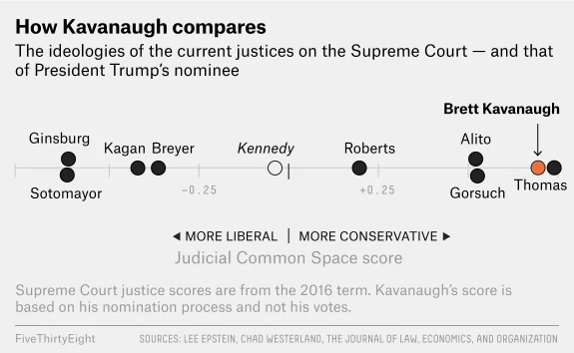
Wildcards
Chief Justice Roberts
  Institutionalist
  Watch Madison v. Alabama (2018)
Potential Kavanaugh recusals on:
  Presidential investigations/policies
  Campus sexual assault issues
  Partisan political matters
Kavanaugh himself
Notes:
Madison v. Alabama…Vernon Madison, an Alabama inmate who has been on death row for more than 30 years for the murder of a Mobile police officer, Julius Schulte. In that time, Madison has had several strokes, causing significant brain damage, and suffers from (among other things) dementia and long-term memory loss; no memory of shooting officer. 4-4 decision previously after Scalia’s death but before In Ford v. Wainwright, the Supreme Court held in 1985 that executing the insane is not allowed due the Eight Amendment, and in Panetti v. Quarterman, they held in 2007 that to be sentenced to death an inmate must understand "the meaning and purpose of" his death sentence.
WE DON’T KNOW Kavanaugh. Remember Reagan appointed both O’Connor AND Kennedy; George H.W. Bush appointed David Souter. Kavanaugh’s Judicial Common Space score uses the ideologies of the nominating president and the judge’s home-state senators to triangulate a judge’s ideology. The latter is included as a nod to the norm of “senatorial courtesy” — the tacit agreement that other senators not support a nominee who is opposed by senators from the nominee’s state.

Slide 13


