Slide 1
Contracts Training
January 29, 2020
Brad Trahan
Assistant General Counsel
704-687-6117

Slide 2
Office of Legal Affairs website,
under Legal Topics:
http://legal.uncc.edu/legal-topics/contracts/contract-checklist

Slide 3
Topics We’ll Cover
The Basics making sure the fundamental questions are answered
Deal Breakers knowing which provisions the University cannot accept
Risky Terms knowing which provisions put the University at risk
Common Sense making sure the contract is fair & meets the unit’s needs

Slide 4
The Basics
Name of party
Offer/Acceptance/Consideration
Attachments/Exhibits/References
  Incorporation, conflicts, links
What is being exchanged/performed?
  Why…

Slide 5
Signature Authority
Campus Partners and Resources
  Legal Affairs
  ITS
  OTT
  Advancement
  University Communications
  Risk Management and Insurance
  YOU
University Policy 603.1
  https://legal.uncc.edu/policies/up-603.1
  Signature Authority Chart

Slide 6
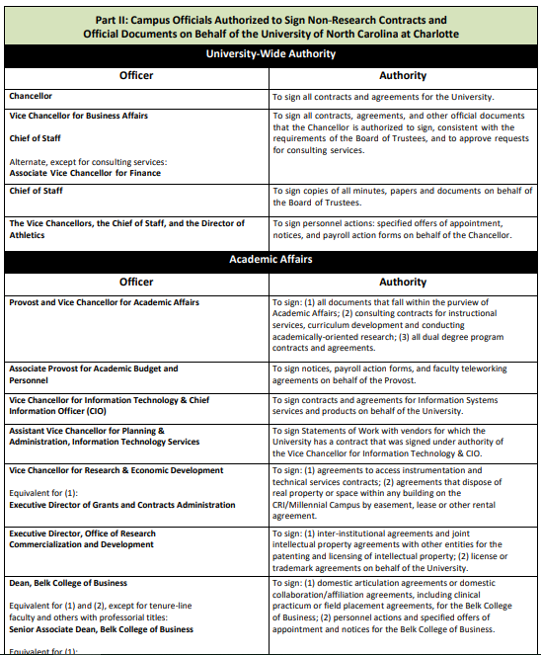
Signature Authority Chart

Slide 7
The Importance of the “Client”
Who are you?
What are the services/goods?
What is our bargaining power?
What is their bargaining power?
How long is the relationship?
Who can terminate/how?
Renewal terms?
What is the consideration?
What are your expectations?
What if things go sideways?

Slide 8
And above all……
Is this a good deal for UNC Charlotte?

Slide 9
When should I use the contract checklist?
contract
agreement
memorandum of understanding
affiliation
grant
lease
etc. – Anytime the university is agreeing to do something (including making payment) in exchange for another party’s action or service
Remember, the checklist is only a guideline, we must be thoughtful about your specific circumstances

Slide 10
Why should I use the contract checklist?
Clarity and avoidance of doubt
  Know who is supposed to do what, when, and how
Avoidance of liability
  Protect yourself, your department, and the University
Enforceability
  Make sure it’s legally binding
Guidance…not gospel

Slide 11
Deal breakers
Substantive law/Arbitration
Indemnification*
  Start with one-way (favoring UNC Charlotte), then remove entirely, then mutual, then negotiated.
  Carefully understand the scope of the indemnity.
  Read in conjunction with limitations on liability.
Notes:
Substantive Law
§ 22B-3. Contracts with forum selection provisions.
Except as otherwise provided in this section, any provision in a contract entered into in North Carolina that requires the prosecution of any action or the arbitration of any dispute that arises from the contract to be instituted or heard in another state is against public policy and is void and unenforceable. This prohibition shall not apply to non-consumer loan transactions or to any action or arbitration of a dispute that is commenced in another state pursuant to a forum selection provision with the consent of all parties to the contract at the time that the dispute arises.
Indemnification:
Start with their indemnifying us for: (1) third party claims when purchasing software/services; (2) claims arising out of the DPA; (3) acts or omissions of employees/agents
We should really only be indemnifying other parties for acts or omissions of our employees when we are purchasing goods/services. There are other possibilities here, but it is going to depend on what we are purchasing and our responsibilities under the contract.
Contracts where we are hiring a contractor to perform work versus contracts where we are partnering with contractor to perform work jointly
Adding “Subject to limits in Tort Claims…” is not going to be enough. Always add it, but we need to be doing more.
This is just an exercise in risk allocation. There will be very few situations where all risk falls on university

Slide 12
Deal breakers
Personal liability for signer (“guarantee”)
Non-compete clause
No-hire clause
Limitations on Liability
  Negotiate thoughtfully with an understanding of client’s interest
Notes:
No-hire: Required to hire most qualified applicant NCGS 126-14.2(2). You can tell other party we will follow our standard HR hiring practices/open to public etc.
Limitations on Liability:
Be thoughtful about what we are expecting and ask yourself, “what if things go south?”
What are the client’s interests? They are the ones assuming these risks
Start with carving out: (1) Claims that are covered by Indemnification clause; (2) Claims for which they are insured; (3) Claims arising out of DPA violations; (4) other claims depending on what the contract is. Ex – we are not going to have a limitation on liability for actions arising out of third party IP claims if the sole service they are providing is developing website content; (5) *negligence?(this may be already addressed in the indemnification carve out, but you have two shots at this one here).
Liquidated Damages/Cancellation Fees/Injunctive Relief/Limitations of Liability/Control of Lawsuits: G.S. 116-4 - The attorney general gets to do his/her job

Slide 13
Risky clauses
Shorten statute of limitations
  e.g. must bring claim within 6 months
Injunctive relief (irreparable harm)
Liquidated damages/cancellation fees
Limit other party’s liability

Slide 14
Example
Scenario: Your unit contracts with Vendor to purchase a Do-It-All Machine for $50,000. Contract limits Vendor’s liability to the cost of the Machine. Machine indeed “does it all,” but it also causes $100,000 in damages to the Machine Room.
Result: Vendor invokes limitation of liability clause and pays only $50,000; your unit is responsible for the remaining $50,000 to repair the damage.

Slide 15
Risky clauses
Waiver of trial by jury (G.S. § 22B-10)
Confidentiality
  Need to refer to NC Public Records Act (G.S. § 132-1, et seq.)
  Address confidentiality of our data if applicable
Use of University name/logo/trademark
  NCAC Title 1 Chapter 5B part .1516
Governing Terms
Intellectual Property Clauses
Notes:
Governing Terms:
- Be mindful of contractors who link out to other T&Cs and say those shall govern. Must add language showing that the terms of the Agreement govern in the event of a conflict. I would do the same thing for POs, invoices, Exhibits, etc.
IP Terms:
They shall have secured all IP rights/licenses necessary to perform their obligations under the agreement (must also include in the indemnification and limitations on liability sections). Ex – Video Production contract/live performance contract/social media campaign contract/any software purchase/etc.
Right of ownership

Slide 16
Contract advisory
For risky terms
Notifies decision-maker that:
  Legal advises against clause
  Losses will be paid from signing unit’s budget
Keep contract advisory on file with contract (internal; doesn’t go to other party)

Slide 17
Data/information
Data Protection Agreement
Personal identifiers
  G.S. § 132-1.10 & § 14-113.20(b)
  FERPA/HIPAA
Accessible for public records requests?
Notes:
Get the DPA process going as soon as possible for software agreements
Software agreements.
Ask: What is being transferred into their software (FERPA, PHI, PII)? Who is responsible for managing/securing system and data? Is this reflected in the indemnification/warranties/limitations on liability/etc.? Have you consulted with appropriate campus partners?
Ask client: Do they want to allow subcontracts? If so, is there language that holds subs to the same standards of their agreement or at least FERPA language? Termination and data migration expectations? Disaster Recovery plans? Cyber Insurance? Service Level expectations?
Contractor shall only use data to fulfill obligations set forth in the Agreement

Slide 18
Pricing Terms
Can be used as a negotiation tool for other clauses in the contract
Services rendered/accepted
Termination/Locked In/Exclusivity
Recover expenses incurred by University
Notes:
A note: Make everything mutual. If they aren’t willing to do that, it is a red flag.
Always ask: What if things go sideways?
Do the terms match what the department’s needs are?
Fixed prices? Fees? Etc. Work with business client on these.

Slide 19
Recent additions
E-Verify provision (G.S. § 143-48.5)
  purchasing contracts
Equal opportunity clause
  added veteran and disability language
ADA Accessibility for Web Services
Business Associate Agreements

Slide 20


Final thoughts
Using University templates can save time
Legal Affairs is always available!
  to review entire contracts
  to answer specific questions
My contact information:
brad.trahan@uncc.edu
7-6117
Notes:
Make things mutual
Stand silent (don’t be afraid to start by deleting – esp indemnification), especially if it doesn’t seem applicable to the purpose of the agreement (data security language in a facility use agreement)
Less can be more
Consult with us and your clients
-
Understanding the other side is also important
ADA web accessibility language not necessary for non web service providers (and not always necessary, again, understand your client)
E Verify for small companies (“To the extent applicable and required by…” is a good add in for both sides)
Understanding their restrictions and pain points can help in negotiating our restrictions and pain points

Slide 21
Questions?

