Slide 1
Do We Have a Policy About That? Do We Need One?
Tips on Navigating and Developing University Policies
Division of Institutional Integrity Fall Legal Symposium
October 16, 2018
Presented by Amy S. Kelso, Senior Associate General Counsel

Slide 2
Overview
This session will cover:
Purpose of University Policies
How to navigate University Policies website
Explanation of what University Policies ARE and what they are NOT
How to determine whether a new University Policy is needed
Tips on drafting/developing new University Policies
Review of “policy on policies,” University Policy 805, University Policy Development, Approval, and Publication

Slide 3
Why do we need University Policies, anyway?
University Policies support institutional stability and enhance University’s mission:
Inform & educate University community
Provide clarity & guidance to University community
Promote consistency in treatment of issues
Set standards for community behaviors
Facilitate operational efficiencies
Establish responsibility & accountability
Enable coordinated compliance with external laws, regulations, & policies
Reduce institutional risk

Slide 4
Navigating University Policies
Where to find them?

Slide 5
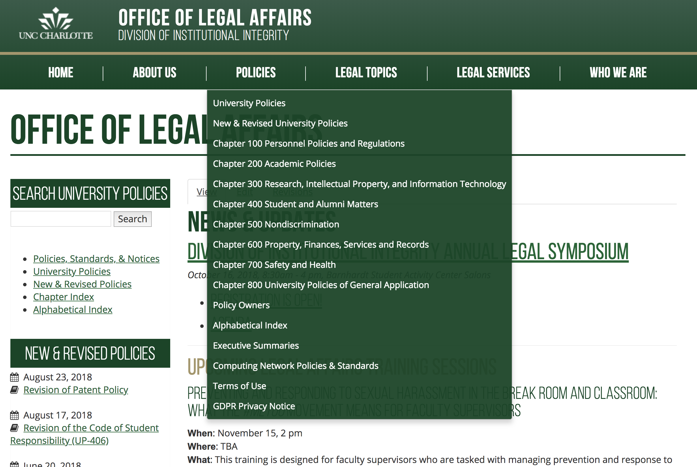
Quickly access University Policies page & subject chapters from drop-down menu at legal.uncc.edu

Slide 6
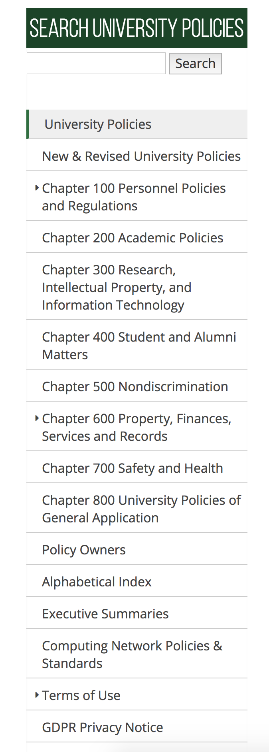
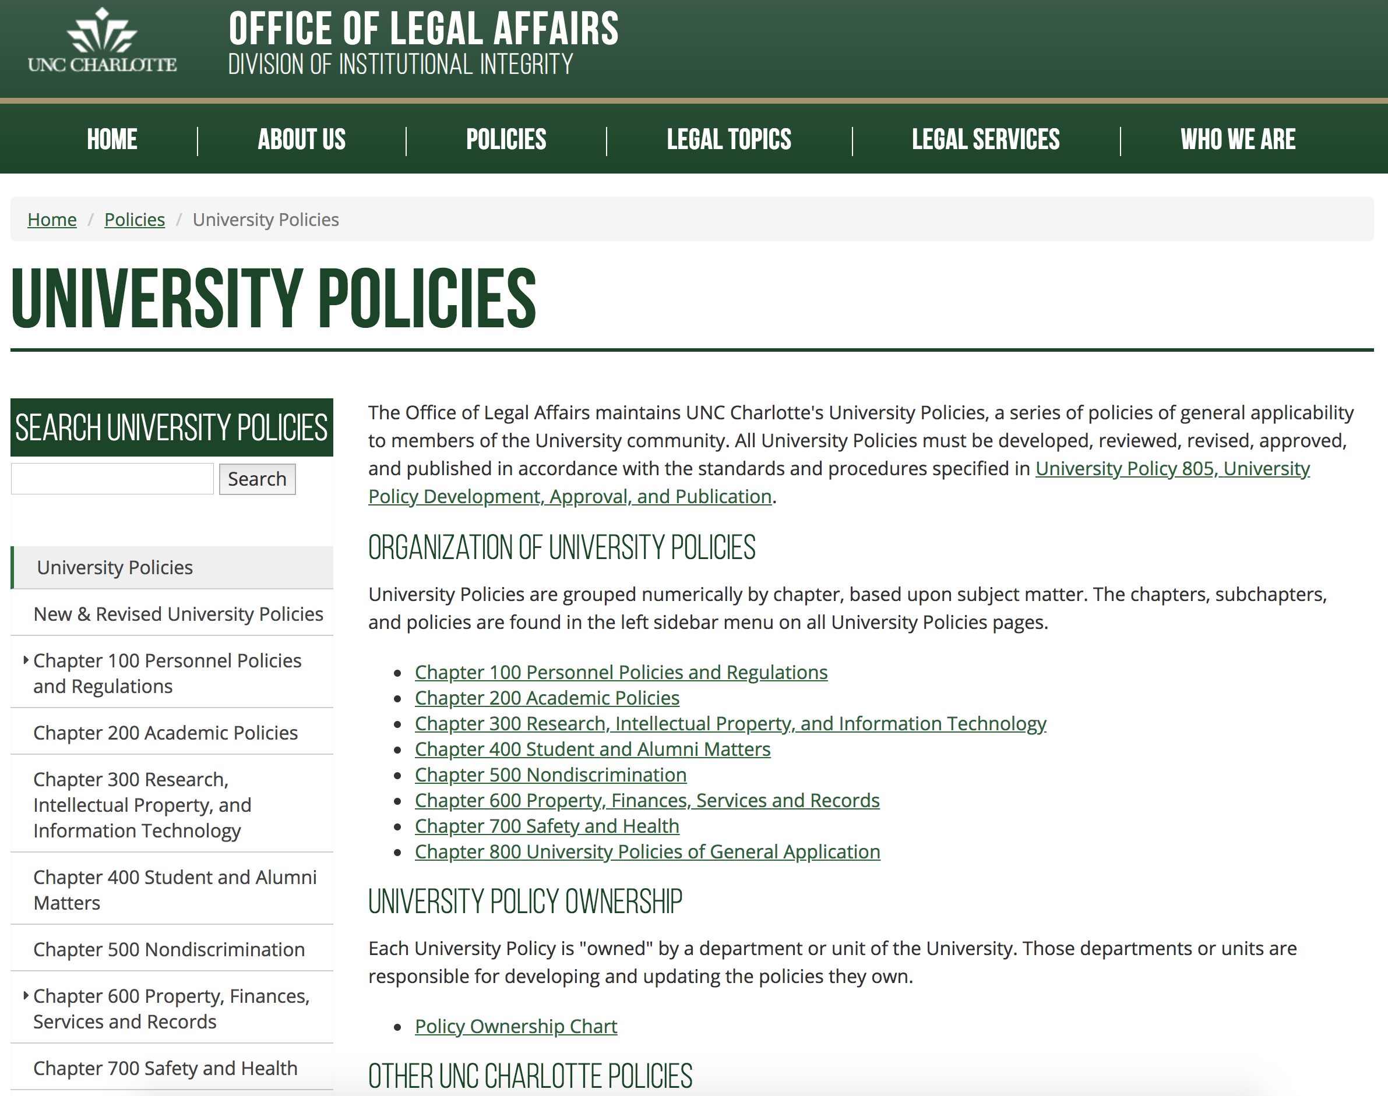
University Policies Website legal.uncc.edu/university-policies

Slide 7


What IS a University Policy?
And what is NOT?

Slide 8
What IS a University Policy?
A written statement of policy of general applicability to members of the University community
Developed by a college, department, or unit (responsible office/owner)
Reviewed/recommended by Chancellor’s Cabinet
Approved by Chancellor (or Board of Trustees, when required)

Slide 9
What IS a University Policy? contd.
Declares institutional principles & standards
Establishes definitions & applicability
Establishes procedures
Prescribes/proscribes behavior
Establishes consequences for violations
Assigns roles and responsibilities
Includes revision history, approval authority, responsible office/owner
Lists related resources
(see University Policy 805)

Slide 10
What is NOT a University Policy?
University Policies do NOT include:
College/departmental policies, which
  apply only to the operation of a specific college, department, or unit
  promote operational efficiencies but are not broadly applicable
Procedures or regulations that
  implement or supplement University Policies
Guidelines that are suggestive but not prescriptive
PIMs (Personnel Information Memoranda; see UP-104)
PATS parking ordinances & traffic policies

Slide 11
What is NOT a University Policy? contd.
Supplemental Procedures or Regulations Appended to some University Policies, they --
contain specific mechanisms or processes related to how to apply a University Policy
include detailed instructions, steps, and/or forms that facilitate compliance with a University Policy
are more easily revised than a University Policy
Note: Not all University Policies include Supplemental Procedures or Regulations

Slide 12
New University Policies…
Do we already have one?
If not -- do we need one?
If so -- how do we get one?

Slide 13
Step 1: Do we have a policy about that?
Identify whether we already have a policy:
  Check University Policy chapter/subject index
  Search University Policies website using key words in search box
  If a current University Policy does not address the situation, check other policies, e.g., Academic Policies & Procedures, Research Policies, Library Policies, IT Policies, Facilities Management Policies, etc. (see links on University Policies website)

Slide 14
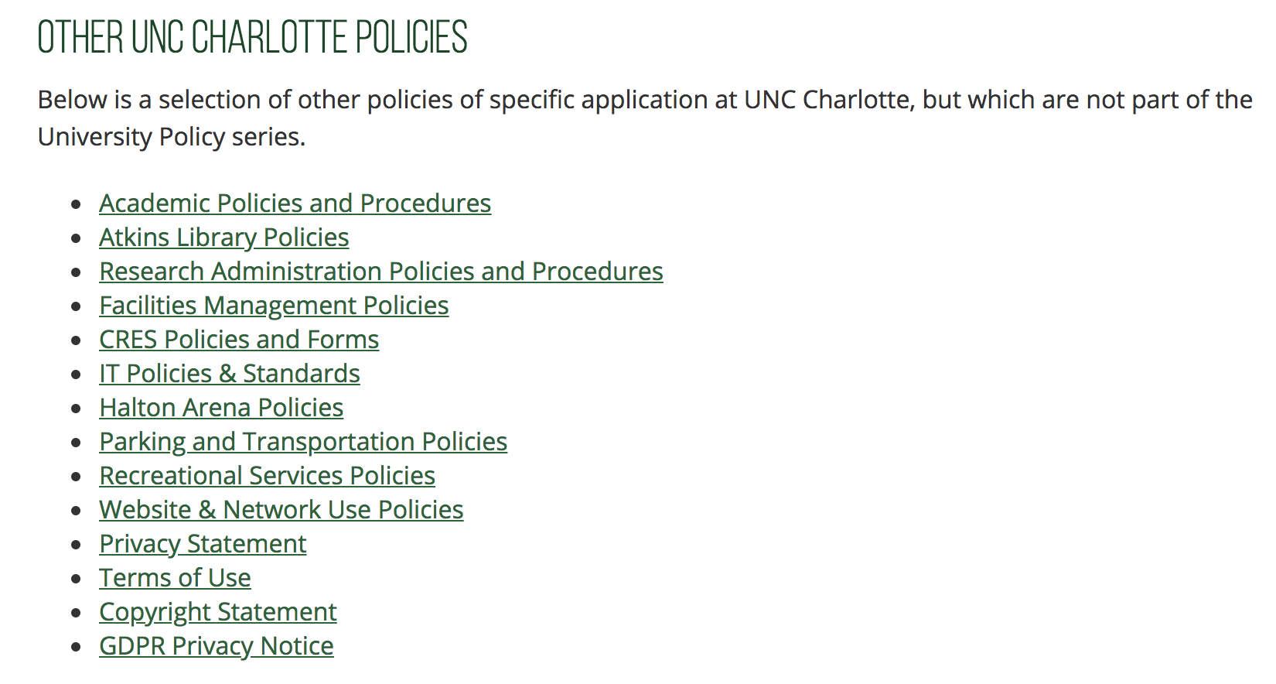
Step 1: Do we have a University Policy about that? contd.
legal.uncc.edu/policies/university-policies

Slide 15
Step 2: So there isn’t a University Policy; how do I know whether we need one?
Does the situation call for a University Policy?
Or is it an internal/departmental issue?*
Or a procedural issue?*
Or a performance (people) issue?*
Or an implementation (systems) issue?*
Or just a particular circumstance that has arisen?*
If none of the above, it may be a candidate to become a new University Policy!
* Avoid the tendency of “policy on particulars”

Slide 16
Step 3: Identify responsible office
A unit will be the “responsible office” (or “policy owner”) when --
  Subject matter of policy is central to the function of the unit
  Unit’s expertise is imperative to understanding how current systems function & determining whether a new policy is needed
  It is a unit without whose support the policy cannot be implemented
Contact responsible officer (Vice Chancellor or designee) to discuss necessity of new policy
Responsible office must oversee/endorse new policy development

Slide 17
Step 4: Ask the big questions
Who (in Responsible Office and beyond) will be involved in initial discussions?
Who will be involved in drafting?
What will be the policy’s direction and scope?
What are the central issues/situations this policy will address?
What specific problems need to be resolved (or prevented from occurring)?
Identify constituents--to what or whom will this policy apply?
What procedures will it establish?
Will the administration support the policy?

Slide 18
Step 5: Organize & draft
Once the advisability of a new policy is established & drafters have been identified, organize policy draft --
Outline keeps the writer(s) out of the weeds
Discern what is policy vs. what is procedure
Review University Policy 805, University Policy Development, Approval, and Publication for guidance
Download University Policy template (see next slide)
Contact Legal Affairs for guidance/assistance in drafting and review

Slide 19
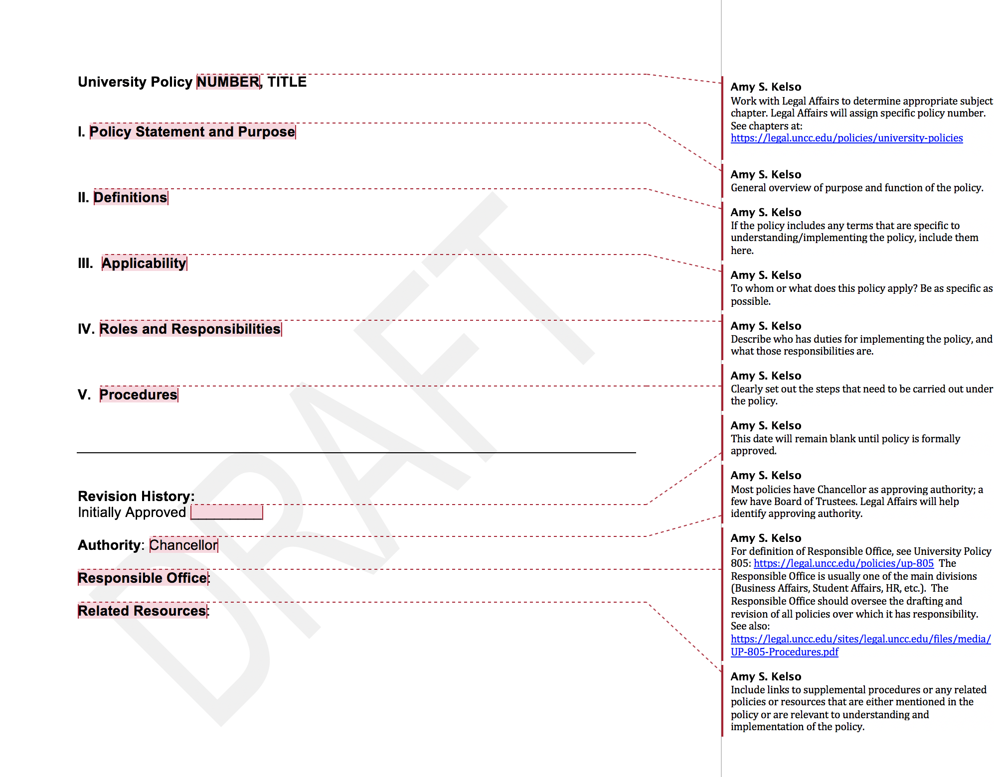
Download University Policy template
legal.uncc.edu/sites/legal.uncc.edu/files/media/UniversityPolicy-Template.docx

Slide 20
Overview of University Policy 805 (“policy on policies”)
University Policy 805, University Policy Development, Approval, and Publication, legal.uncc.edu/policies/up-805
Purpose is to create consistency in
  Development/drafting
  Format/structure
  Review/revision
  Approval process
Includes policy template to guide drafting
Includes supplemental procedures for adding or revising University Policies

Slide 21
Roles and Responsibilities
Office of Legal Affairs
Manages process for development, approval, & publication of University Policies
Ensures that University Policies are consistent with applicable laws, regulations, & governing policies
Determines who has approval authority for each University Policy, according to applicable laws, regulations, and related policies
Determines whether a proposed policy follows the requirements for a University Policy

Slide 22
Roles and Responsibilities (contd)
Responsible Office (Policy Owner)
Owns, develops, & administers a particular University Policy and any Supplemental Procedures or Regulations
Accountable for the accuracy of the policy
Responsible for following procedures & standards of UP-805 in policy development/revision
Ensures that University Policies it “owns” are:
  consistent with other policies within its area
  communicated properly
  reviewed, revised, & updated as needed
  monitored for compliance and effectiveness
Policy Owners: legal.uncc.edu/policy-owners

Slide 23
Roles and Responsibilities (contd)
Chancellor’s Cabinet
Responsible for reviewing and recommending the approval or revision of University Policies.
Chancellor
Responsible for final approval of University Policies over which Chancellor has authority, such authority being determined by governing policies/regulations
Board of Trustees
Responsible for final approval of University Policies over which it has authority, such authority being determined by governing policies/regulations

Slide 24
Policy Standards
Clear and concise
Contains sufficient information on the subject without being excessive in length
Detailed mechanisms or processes are reserved for supplemental procedures/regulations or departmental policies

Slide 25
Policy Format
Policy Title
Policy Statement and Purpose
Definitions
Applicability
Procedures
Roles and Responsibilities
At the end:
  Revision History (including initial effective date & all revision dates)
  Authority (Chancellor or Board of Trustees)
  Responsible Office/Policy Owner
  Related Resources
(See policy template)

Slide 26
Approval Exceptions
Clerical Changes
Some clerical or non-substantive revisions to existing University Policies may be approved by the Responsible Office and the Office of Legal Affairs without full review and recommendation by the Chancellor’s Cabinet or approval by the approving authority
Supplemental Procedures or Regulations
May initially be developed, revised, and approved as part of the approval of a new or revised UP, but may also be revised or updated without additional review and approval of the approving authority

Slide 27
Policy Review
Every University Policy will be reviewed at least every five years by the Responsible Office for that policy, or more frequently, if necessary.
Responsible Office will propose revisions or updates on an as-needed basis to keep the Policy current and whenever necessary to comply with regulatory changes or changes in business operations.
Office of Legal Affairs will oversee the review/revision process.
Policy revisions will follow the same review and approval process as for new University Policies.

Slide 28
Policy Publication/Distribution
All approved University Policies and supplemental procedures or regulations will be published on the official University Policy site (legal.uncc.edu/policies/university-policies).
If a unit wishes to include University Policies on its website, it must do so by linking to the official University Policy site to ensure that the official version is referenced.
The official University Policy site will be the only site that carries the assurance that the University Policies posted on it are current and correct.

Slide 29
Policy Development or Revision,
Step-by-Step legal.uncc.edu/sites/legal.uncc.edu/files/media/UP-805-Procedures.pdf
Step 1
New policy or revision requests must be initiated by Chancellor or a Chancellor’s Cabinet member or designee
Requests must be sent to the Office of Legal Affairs (OLA)
Step 2
  OLA reviews new policy draft or revision
  OLA works with requestor/Policy Owner to develop draft of the new policy or revision
  OLA makes recommendations as to form, format, clarity, substance, and legal implications

Slide 30
Policy Development/Revision,
Step-by-Step
Step 3
Once revision/drafting process is complete, OLA determines that draft is in good legal form
OLA emails to Chancellor and Cabinet members:
  New policy draft or redlined version of revised policy
  Explanatory memo
OLA sets a deadline for comments
Step 4
OLA collects comments/recommendations from Chancellor, Cabinet members/designees
OLA works with requestor/Policy Owner on additional revisions

Slide 31
Policy Development/Revision,
Step-by-Step
Step 5
  Once policy finalized, it is placed on Cabinet meeting agenda:
    3 weeks time, if no revisions
    follow-up Cabinet meeting, if necessary
    additional Cabinet meetings, if inability to resolve issues
Step 6
  If under Step 5, Chancellor determines further editing/revisions, OLA will:
    work with unit/Policy Owner to draft revisions
    re-submit revised draft for Cabinet review or solely to Chancellor, if so requested
    step 6 will repeat, if necessary, until policy
    approved

Slide 32
Policy Development/Revision,
Step-by-Step
Step 7
If Chancellor authorized to approve, OLA produces an approval letter for Chancellor’s signature, along with final draft (approval process complete)
If BOT authorized to approve, OLA places it on BOT agenda for next regular meeting, along with resolution and memo and final draft, if approved (process complete)

Slide 33
Policy Development/Revision,
Step-by-Step
Step 8
Once final approval complete, OLA will:
  post new policy on OLA website
  create revision page for policy under “Recent Revisions” web page
  Submit announcement to Inside UNC Charlotte for publication
  Notify Policy Owner and Cabinet Members and request that they disseminate the new/revised policy to their units, as appropriate.
Step 9 – FINAL
OLA maintains a digital copy of the expired version of the policy in its archive files

Slide 34
Questions?
Amy S. Kelso
  Senior Associate General Counsel, Office of Legal Affairs
  Phone: 828-232-4990, Email: amy.kelso@uncc.edu

