Slide 1
Understanding Sexual Assault, Relationship Violence, and Stalking: Creating an
Informed Campus Culture
Office of Legal Affairs Symposium
October 16, 2014
Dawn Floyd, JD, Title IX Coordinator
Nicole Madonna-Rosario, LCSW, Interpersonal Violence Prevention Specialist

Slide 2
Its On Us – All of us!
http://itsonus.org/#videos

Slide 3
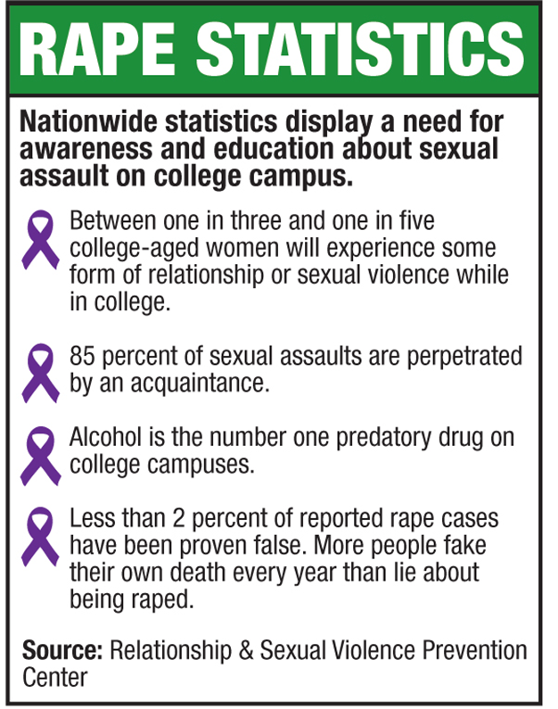
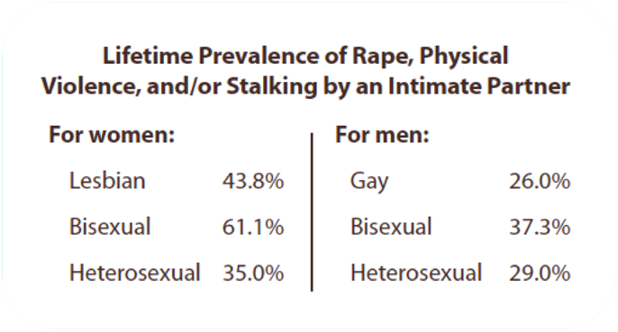


Slide 4
Stalking Statistics
1 in 6 women and 1 in 19 men have experienced stalking victimization at some point during their lifetime in which they felt very fearful or believed that they or someone close to them would be harmed or killed.
The majority of stalking victims are stalked by someone they know. 66% of female victims and 41% of male victims of stalking are stalked by a current or former intimate partner.
More than half of female victims and more than 1/3 of male victims of stalking indicated that they were stalked before the age of 25

Slide 5
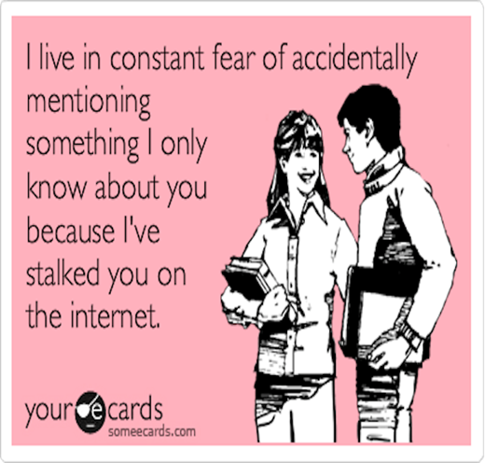
Examples of Stalking
Stalking can take many forms- here are some examples:
Excessive phone calls (including hang-ups) or text messages
“Cyberstalking”- Using social media as a tool to monitor the actions of the victim
Showing up uninvited to home, work or school
Send unwanted gifts, letters, emails
Make threats to harm you or your friends or family

Slide 6
Scope of the Issue- Relationship Violence
1 in 4 women (24.3%) and 1 in 7 men (13.8%) aged 18 and older in the United States have been the victim of severe physical violence by an intimate partner in their lifetime.
Nearly half of all women and men in the United States have experienced psychological aggression by an intimate partner in their lifetime
Females ages 18 to 24 and 25 to 34 generally experienced the highest rates of intimate partner violence.
For lesbian and bisexual women: Lesbian – 43.8% Bisexual – 61.1%
For men: Gay – 26.0% Bisexual – 37.3%
Transgender individuals are less likely to report and so the statistics specific to them are limited. Most reports are local but most show that the rates of violence are much higher
http://www.cdc.gov/violenceprevention/pdf/nisvs_sofindings.pdf

Slide 7
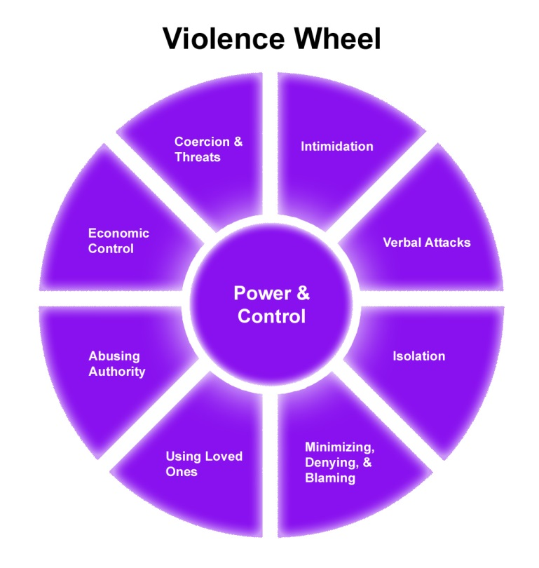
Relationship Violence
Verbal
Psychological
Emotional
Financial
Physical
Immigration status
Pet abuse
Child abuse
Contraceptive abuse
Gender privilege
Technology

Slide 8
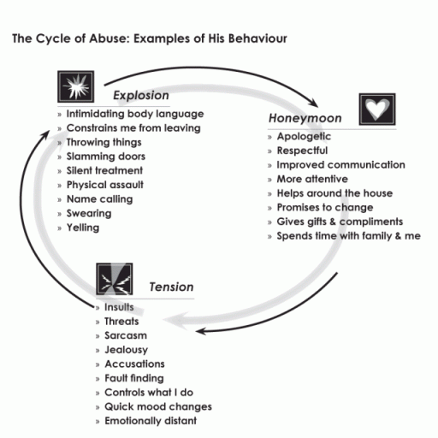
The “honeymoon” phase is the part of the cycle used to manipulate the victim into staying and often reminds them of the person they originally started dating.
Over time the abuser spends more time in the “tension” and “explosion” phase and the honeymoon phase drops off.
We will see victims of dating violence most frequently immediately after the explosive phase- in crisis and very vulnerable.
The honey moon phase is one of the reasons that it is very difficult for victims to leave their abusers.
Cycle Of Abuse: Copywrited in 2008 by Jill Cory & Karen McAndless-Davis

Slide 9
Why all the fuss?
To address what many call the “epidemic” of sexual violence on college campuses
One in five college women report surviving rape or attempted rape while in college;
In 72-81% of cases in which a male rapes a female college student, the female is intoxicated.
Between 60-90 % of victims know the accused.

Slide 10
Why all the fuss?
If complaints are not handled to all parties’ satisfaction or are mishandled/ignored, the stories garner attention from the media and from the Office of Civil Rights.
At least 70 colleges and universities are currently under investigation by OCR
At least 30 men have filed lawsuits alleging violations of due process and severe emotional distress resulting from the way their cases were handled

Slide 11
Title IX
• prohibits discrimination on the basis of sex
(including sexual harassment, sexual assault, and other forms of sexual misconduct)
Campus SaVE Act/VAWA (amendment to Clery)
• provides certain notification and procedural rights to victims of sexual assault, domestic violence, dating violence, and stalking
Clery Act
• requires reporting of crimes (including sex offense, domestic violence, dating violence, and stalking) on or near campus
The Law

Slide 12
Code of Student
Responsibility
• Sexual harassment = unwelcome, gender-based verbal or physical conduct of a sexual nature that is based on a power differential
Sexual assault = sexual act (intercourse or oral sex) or sexual contact (touching of intimate parts) without consent
Sexual exhibitionism = engaging in sex or exposing one’s intimate parts (buttocks, genitalia, groin, breast (unless breastfeeding)) in the presence of others.
• Sexual exploitation = (e.g. non-consensual explicit photographs,
prostituting someone, voyeurism)
• Stalking = two or more acts directed at a specific person that would
cause a reasonable person to (a) fear for his or her safety or (b) suffer
substantial emotional distress
• Relationship violence = dating violence or domestic violence

Slide 13

What is Rape Culture?
Rape Culture is when we have become desensitized to rape and sexual assault because these acts have become normalized through media and other imagery.

Slide 14
Lets Break it Down
We understand the word CULTURE to be related to things that members of a society do together like education, the arts and practicing good table manners
Of course we understand that in general our culture does not outwardly promote sexual violence (although there are some cultures that do)
So…where does the word RAPE fit in?

Slide 15
Break it Down Further
Rape culture refers to the cultural practices that a society has in place that further perpetuate certain gender norms and social “rules” of behavior
These practices tend to excuse and even tolerate sexually violent acts
Its about how we think as a group about rape
More often than not, it’s situations in which sexual assault, rape, and general violence are ignored, trivialized, normalized, or made into jokes.

Slide 16
Some Examples
Blaming the victim (“She asked for it!”)
Trivializing sexual assault (“Boys will be boys!”)
Sexually explicit jokes
Tolerance of sexual harassment
Inflating false rape report statistics
Publicly scrutinizing a victim’s dress, mental state, motives, and history
Gratuitous gendered violence in movies and television
Defining “manhood” as dominant and sexually aggressive
Defining “womanhood” as submissive and sexually passive
Pressure on men to “score”
Pressure on women to not appear “cold”
Assuming only promiscuous women get raped
Assuming that men don’t get raped or that only “weak” men get raped
Refusing to take rape accusations seriously
Teaching women to avoid getting raped instead of teaching men not to rape

Slide 17
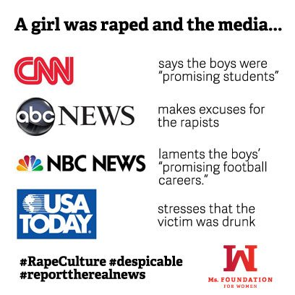

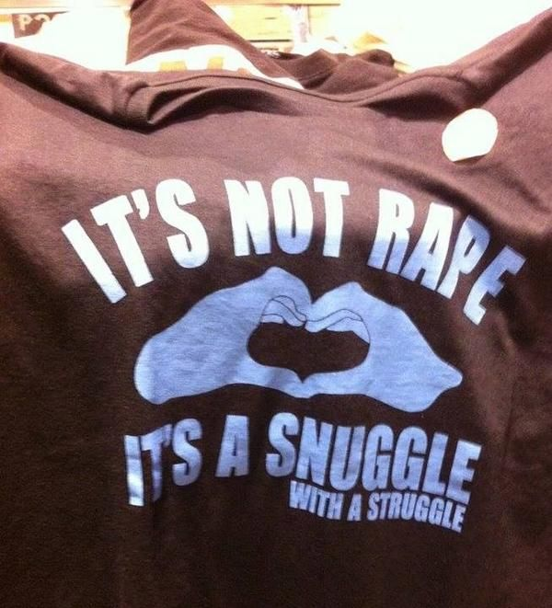


Slide 18
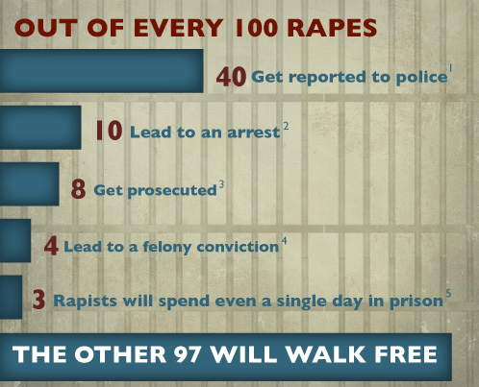
Barriers to Reporting
Many victims know their perpetrator
Fear of not being believed (“slut-shaming”, victim blaming)
Fear of police or medical procedures
Fear of discrimination or prejudice
fear of retaliation
Assumption of heterosexuality and/or fear of being “outed”
Shame, guilt, embarrassment
Financial dependence on the perpetrator
Family member committed the assault

Slide 19
Responsible Employee = any employee . . .
• who has the authority to take action to redress sexual violence;
• who has been given the duty of reporting incidents of sexual violence or any other misconduct by students to the Title IX Coordinator or other appropriate school designee; or
• whom a student could reasonably believe has this authority or duty
Title IX

Slide 20
Responsible Employee =
• all Cabinet members • all faculty members
• Police & Public Safety • Human Resources
• Dean of Students office • Coaches, trainers
• Housing staff, RAs, RCs • security personnel
• Teaching Assistants • certain PaTS staff
• Staff with supervisory responsibilities
Title IX

Slide 21

Confidential Resources at UNC Charlotte:
• Student Health Center
• Counseling Center
• Center for Wellness Promotion
Confidential Resources can keep reports from students confidential and reports will not initiate an investigation by Police and Public Safety or the Title IX Office

Slide 22
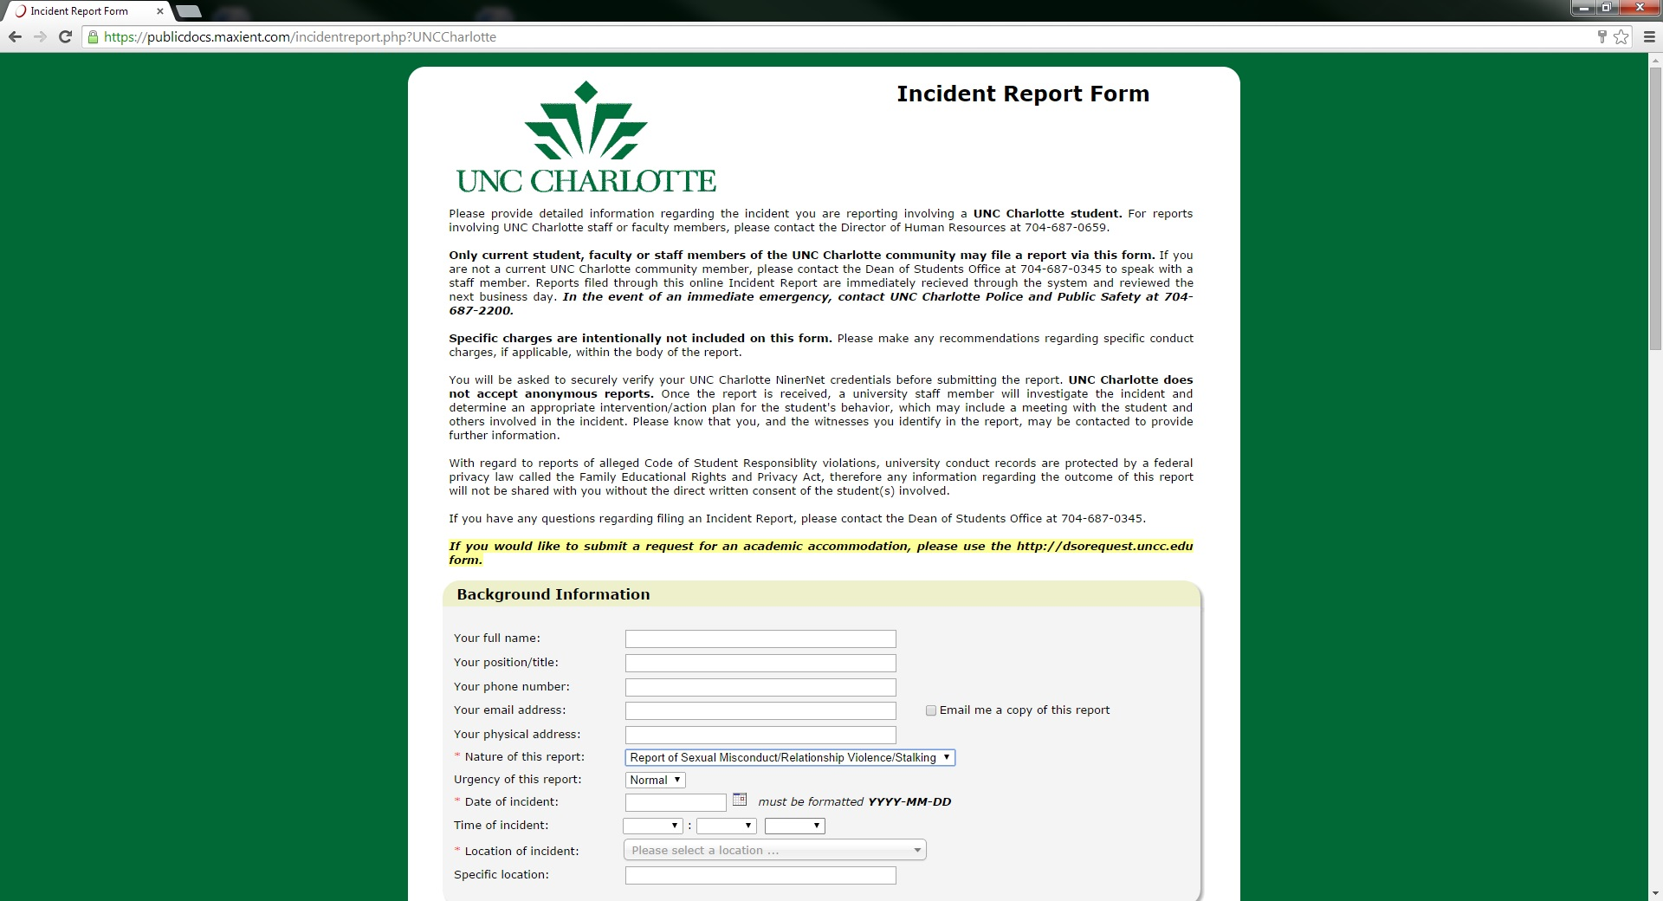
Go to:
incidentreport.uncc.edu

Slide 23
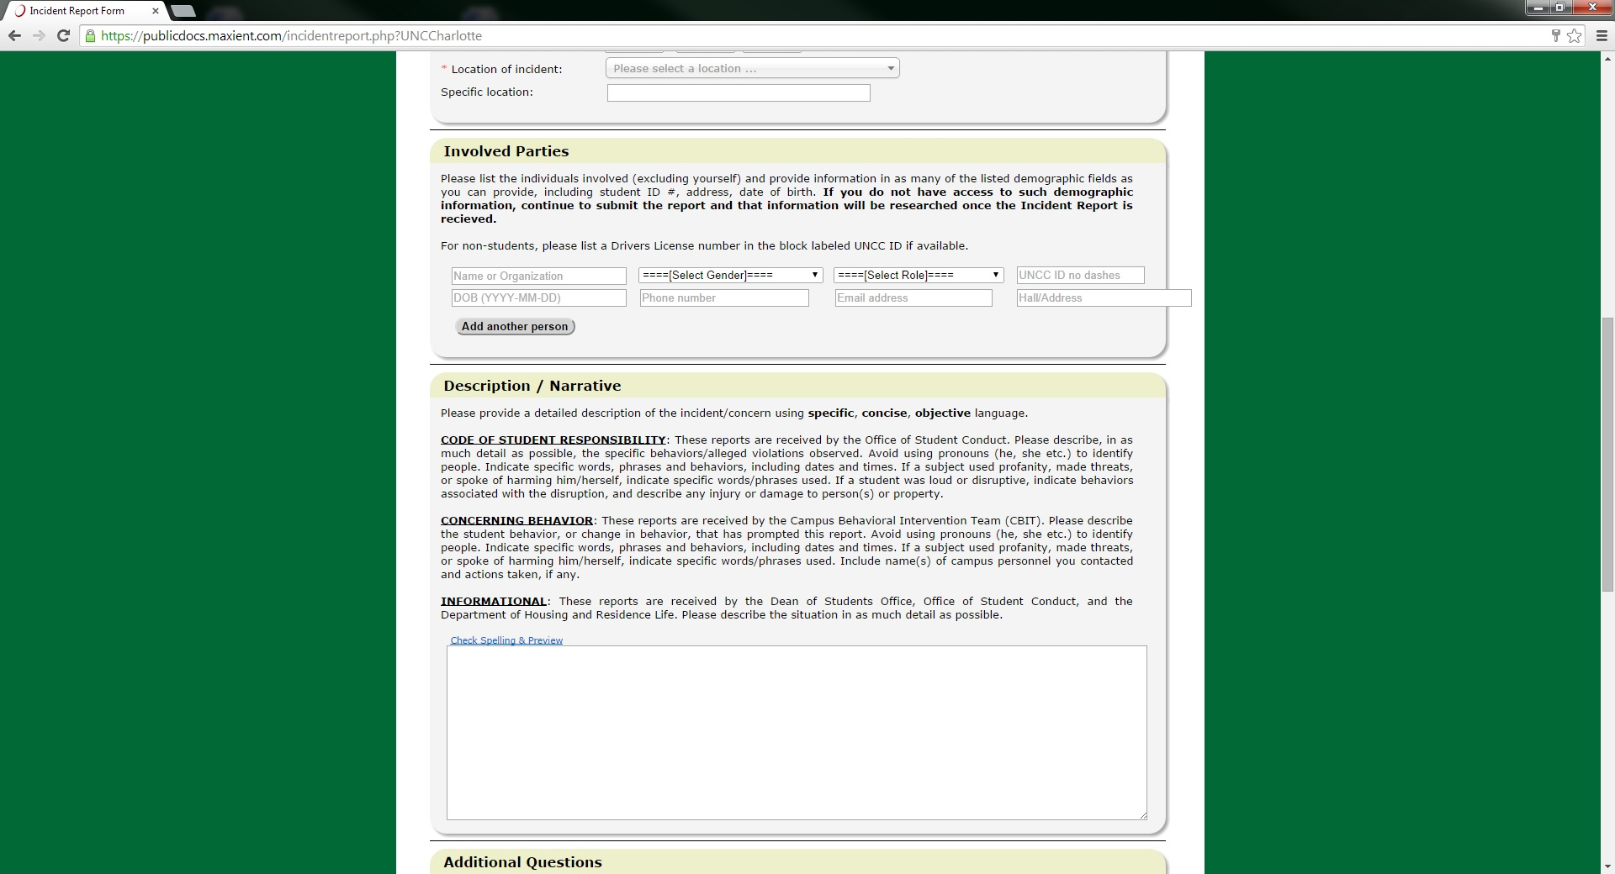

Slide 24
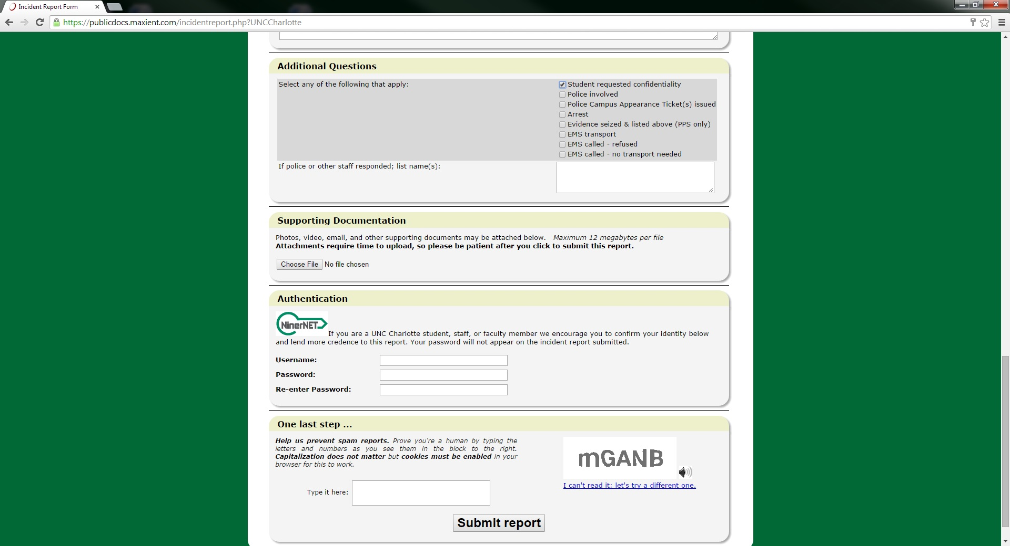

Slide 25

Another reporting option
Title IX Coordinator, Dawn Floyd – 704-687-6130
Title IX Deputy Coordinator for Academic Affairs, Katherine Hall-Hertel – 704-687-5661
Title IX Deputy Coordinator for Human Resources, Jeanne Madorin – 704-687-0659
Title IX Deputy Coordinator for Students, Christine Reed Davis – 704-687-0345
Title IX Deputy Coordinator for Athletics, Kim Whitestone – 704-687-4955

Slide 26
Overview of complaint
resolution process
University learns of a complaint of sexual assault, domestic violence, dating violence or stalking;
Assistant Dean of Students meets with Complainant and Respondent (if victim doesn’t request confidentiality) to discuss resources, accommodations and explain Title IX process;
Title IX Investigator talks with Complainant about his/her wishes in the Title IX process;
Title IX Investigator conducts investigation and submits report to Office of Student Conduct;
Office of Student Conduct determines if the Code of Student Responsibility has been violated and, if so, determines the appropriate sanction;
Complainant or Respondent can reject findings or sanctions;
Case is heard by a hearing panel comprised of faculty and staff;
Decision of hearing panel communicated to both parties;
Parties can appeal

Slide 27
Title IX Priorities and Initiatives 2014-2015
Nine for IX
Write and/or revise campus-wide policies and protocols for handling reports of sexual misconduct, relationship violence and stalking
Fair, impartial and equitable handling of all reports of sexual misconduct, relationship violence and stalking
Coordinate with the Interpersonal Violence Specialist to provide
awareness and training programs to campus community members,
including bystander training
Implement on-line educational module for all incoming students called Think About It that educates students on alcohol, drugs
and sexual assault in compliance with VAWA

Slide 28
Title IX Priorities and Initiatives 2014-2015
Nine for IX
Publication of Interpersonal Violence Policy and Resource Guide for victims of sexual misconduct, relationship violence and stalking
Develop campus climate survey to be completed by students in spring 2015
Develop structure of Title IX Office and campus-wide Title IX Committee
Coordinate Title IX activities across campus
Ensure compliance with all applicable laws

