Slide 1
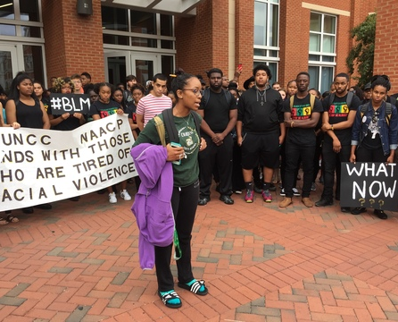
How much for the “Free” Speech?
A Review of the University’s Commitment and Obligation to Foster and Protect Free Speech on Campus
Notes:
NOTE:
To change the image on this slide, select the picture and delete it. Then click the Pictures icon in the placeholder to insert your own image.

Slide 2
“Talk is Cheap. Free Speech Isn’t.”
Overview of Some Recent First Amendment Incidents or Events on College Campuses
Summary of Applicable Law and University Policy
Why We Value Free Speech at UNC Charlotte
How We Balance Protecting and Promoting Free Speech Against Our Commitment to Maintaining a Welcome and Inclusive Working and Learning Environment
How We Prepare for Free Speech Events on Campus to Ensure Safety

Slide 3
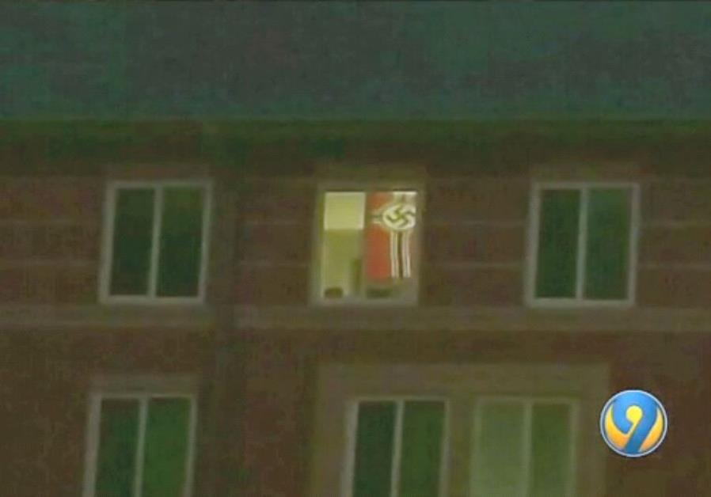
Free Speech Isn’t Always Free
Political speech afforded the greatest protection under First Amendment Jurisprudence;
Political speech and expression encompasses political symbols, such as the flag seen here.

Slide 4
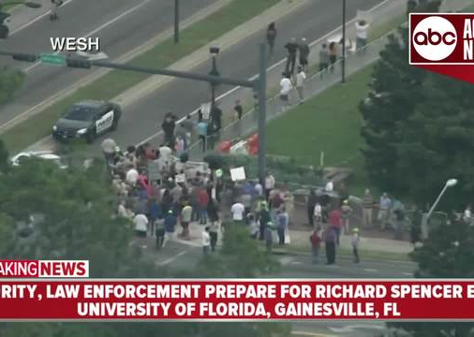
Free Speech Can Be Very Expensive
Hosting Controversial Speakers on Campus has cost Campuses around the Country Millions;
Cancelling or Prohibiting Speakers Based on Anticipated Public Safety Concerns Is Constitutionally-Suspect.

Slide 5
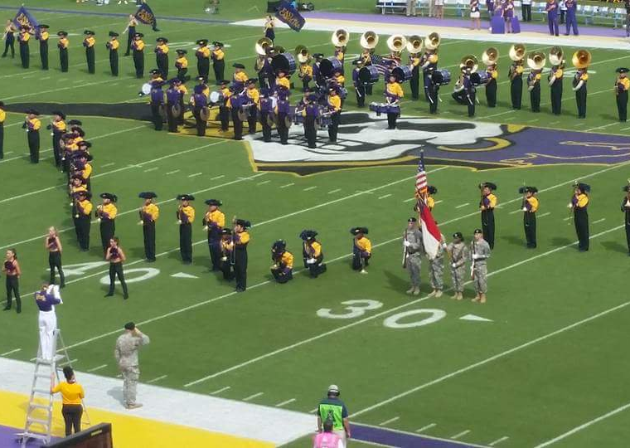
What Constitutes “Protected Speech” on Campus Can Be Confusing
Engaging in impromptu speech activities during official University activities, particularly when the activities are undertaken for academic credit, may be lawfully restricted.

Slide 6
The First Amendment
“Congress shall make no law…abridging the freedom of speech.”
  Freedom from v. Freedom to
  The “Government Action” Requirement
  Constitutionality of Government’s Restrictions on Protected Speech subject to “Strict Scrutiny”
    “Strict in Theory; Fatal in Fact.”
Notes:
Our right to free expression is rooted in the First Amendment, which innovatively restricted our government’s right to regulate speech protected by the amendment. The amendment, which also secures religious liberty and freedom of the press, reads, in part, that Congress shall make no law abridging the freedom of speech). It, therefore, simultaneously affirms the individual’s right to engage in speech activities and the individual’s freedom from governmental restrictions on those activities. Because the amendment only limits the government’s authority to restrict speech, government action must be present in order for the first amendment to apply. As a public institution of higher education, UNC Charlotte is considered a government actor. If and when a government actor engages in restrictions on speech, those restrictions are subject to strict scrutiny when challenged in the courts This means that reviewing courts assess whether the individual’s right to engage in the speech activities is outweighed by a compelling government interest in restricting the speech. Even when courts conclude the government interest is sufficiently great to warrant restrictions of the relevant speech activities, the court further assesses whether the restriction is narrowly tailored to achieve that compelling interest. This means the court will ask whether the government could have achieved the same objective in a less restrictive way. Government restrictions on protected speech rarely survive the court’s rigid scrutiny-so rarely, in fact, that scholars have quipped that the scrutiny is “strict in name but fatal in fact.”

Slide 7
Unprotected Speech
True threats
Inciting or Producing an Imminent Lawless Action
Fighting Words
Obscenity
Libel & Defamation
Discrimination/Harassment
Disruption
Notes:
Recognizing that the first amendment’s language clearly prohibits restrictions on speech that is protected by the amendment, supreme court jurisprudence has carved out certain types of speech as unprotected by the first amendment—finding, essentially, that the speech at issue was never intended to enjoy freedom from government restriction by the authors of the first amendment. Examples of such “unprotected speech” include true threats, fighting words, and speech that incites or produces imminent lawless action. Other examples of speech the courts have concluded to be unprotected by the first amendment include obscenity, libel and defamation, discriminatory harassment, and disruption. Defining each type of unprotected speech in regulations restricting the speech has proven very tricky. The regulations are routinely overturned for overbreadth, for example, meaning that as written, the regulations would tend to capture speech that is indeed protected by the First Amendment.

Slide 8
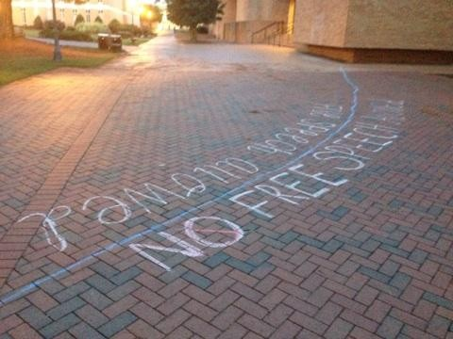
Time, Place and Manner Restrictions
A public university is constitutionally permitted to place reasonable time, place and manner restrictions on speech activities
  Content neutral
  Narrowly tailored/government interest
  Ample alternative means of expression
Notes:
Important for our purposes is the recognition that government actors can impose certain types of restrictions that are content neutral in order to ensure that their government purpose or function is not frustrated by speech activities. As a result, UNC Charlotte can lawfully designate some places on campus as off limits to traditional speech activities, such as protests, because such activities may, for example, disrupt the delivery of instruction.

Slide 9
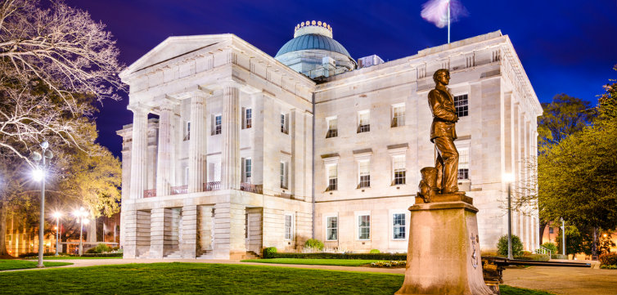
North Carolina Free Speech Bill
  Requires BOG to craft a policy on free expression that can be limited only by “narrowly tailored viewpoint and content-neutral restrictions on time, place, and manner of expression”
  Requires that the policy include a range of disciplinary sanctions for behaviors that “substantially disrupt the functioning of the constituent institution or substantially interfere with the protected free expression rights.”
Notes:
The North Carolina legislature has weighed in on this topic recently, passing legislation that establishes some state-imposed parameters for campus speech policies. As noted here, the state statute is largely duplicative of applicable constitutional jurisprudence on point—allowing for reasonable time, place, and manner restrictions on speech activities, while reinforcing universities’ authority to restrict certain types of unprotected speech-such as speech that is disruptive and, therefore, interferes with others’ rights to free expression. The statute also requires Universities to educate its students on free speech rights on campus and to designate a point of contact on campus charged with clarifying these rights for the campus community.

Slide 10
UNC Charlotte’s Speech Policies
Balance the University’s commitment to free speech, commitment to diversity and inclusion, and commitment to the efficiency of University operations
Restrictions based on “Fighting Words” Doctrine, State and Federal Civil Rights Statutes, and Reasonable Operational Considerations
Notes:
The University has a couple of policies that relate to free speech on campus, including, primarily, University Policy 802, which relates to conduct at speech events. The policy is aligned with the recent North Carolina legislation, to the extent it clarifies the institutional commitment to the open exchange of competing ideas within our diverse campus community, while simultaneously establishing some reasonable limits to speech activities that might unreasonably disrupt the exchange of ideas. As such, this policy balances the right to speak against the right to dissent, prohibiting the imposition of restrictions that favor disruptions that support the speakers point of view as opposed to those of the same type that do not, while also prohibiting dissenting speech activities that unreasonably disrupt the speaker’s ability to communicate or the audience’s ability to hear and see the speaker.

Slide 11
Campus Conundrums
What Speech is Protected by the First Amendment:
  When Speaking as a Student Inside and Outside the Classroom;
  When Speaking Within and Without the Scope of Employment; and
  When Speaking as a Private Citizen?

Slide 12
Balancing Our Commitment to Create and Maintain a Welcoming and Inclusive Learning Environment
Bias Assessment Resource Team (BART)
The purpose of BART is to:
Receive and monitor reports of bias-related incidents to better understand the climate of the student experience at UNC Charlotte.
Review and assess reports and direct those reports to the appropriate unit or department for response
Raise awareness of bias and the impact of biases through education and awareness
Provide assistance, support and guidance to those negatively impacted by bias-related incidents

Slide 13
Balancing Our Commitment to Create and Maintain a Welcoming and Inclusive Learning Environment
BART is not…
a disciplinary body and does not investigate or adjudicate bias-related incidents beyond offering support and assistance to those impacted and directing reports to appropriate unit/departments for response.

Slide 14
Balancing Our Commitment to Create and Maintain a Welcoming and Inclusive Learning Environment
Reporting Options
BART.uncc.edu
An individual can decide if they want to submit the incident as information only or request a meeting to further discuss the incident.
What Happens When A Report is Submitted?
“When a report is submitted, the report will be routed to the Chair of BART for initial review”
BART Chair or team member will reach out to the reporting party to gather information, provide support and connect students to campus resource if needed
BART Chair will forward the incident report to the appropriate unit/department for review and response

Slide 15
Balancing Our Commitment to Create and Maintain a Welcoming and Inclusive Learning Environment
Continued…
If the reporting party believes the incident is a hate crime or violates a university policy, the reporting party is encouraged to report the incident directly to campus police or Student Conduct and Academic Integrity in addition to submitting the Bias Incident Form

Slide 16
Putting Safety First
Role of PPS in advance of and during speech events that we anticipate may pose some public safety concerns
PPS resources for Students and Employees planning to host speech events on campus

Slide 17
Questions?

