Slide 1

Internal Audit
Controls – Who Needs Them?
Molly Murphy CIA, CFE
Raheel Qureshi CPA

Slide 2


Housekeeping:
Please silence your cell phones
Take notes – share ideas!
Feel free to ask questions throughout the presentation.

Slide 3
Internal Audit Mission Statement
To enhance and protect organizational value by providing risk-based and objective assurance, advice, and insight.

Slide 4
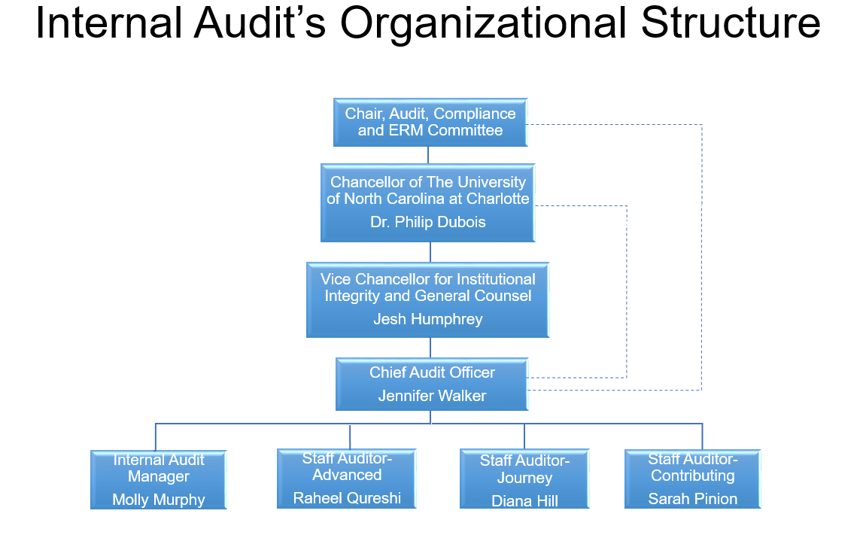

Slide 5

Every profession has its own language, including audit.

Slide 6
What is Risk?
A situation involving exposure to danger. (Merriam-Webster)
The hazard or chance of loss. (dictionary.com)
A probability or threat of damage, injury, liability, loss, or any other negative occurrence that is caused by external or internal vulnerabilities, and that may be avoided through preemptive action. (businessdictionary.com)

Slide 7

What are Internal Controls?
Internal Controls are steps within a process designed to provide reasonable assurance regarding the achievement of objectives:
  Effectiveness and Efficiency of Operations
  Reliability of Financial Reporting
  Compliance with applicable Laws, Regulations, Policies & Procedures

Slide 8
Types of Internal Controls
Preventive:
  Systematic field requirement checks (i.e. the system won’t allow text in a numeric field).
  Assigning user access rights.
  Automatic log-off after a period of inactivity.
  Electronic approvals.
  What are some other preventive internal controls?

Slide 9
Types of Internal Controls
Detective:
  Reconciling invoices to the ledger (payments).
  Review of bank reconciliations.
  Periodic review of user access rights.
  Supervisory review of a report.
  What other detective internal controls can you think of?

Slide 10
What are some of the internal controls that you encounter every day?
  Computer username/password (DUO)
  Preset time out on screen saver
  49er Mart approval path
  Card swipe door locks
  2 signatures on DPRs
  Reconciliations
  Speed limit signs

Slide 11
Process Steps vs Controls
“A process step is a task, activity… that moves an input closer to the final objective.”
  The office submits the reimbursements to the Travel Office within 30 days
  Faculty members verbally request supplies.

Slide 12
Process Step Control
  The department admin collects timesheets and files them.
  The office submits the reimbursements to the Travel Office within 30 days.
  Faculty members verbally request supplies.
  Supervisors review timesheet submissions monthly to ensure they were completed on time.
  Supervisors review and approve all travel reimbursements for accuracy before submission to the Travel Office.
  Department staff match the purchase order, invoice and receiving slip before marking the supply as received in 49er Mart.

Slide 13


Slide 14

App State lost $1.9 million to fraud at hands of LA man, indictment alleges
Excerpt taken from the Winston-Salem Journal Mar 27, 2018
A Los Angeles man stole $1.9 million from Appalachian State University by creating a fake company and posing as an employee of a construction company the university hired to construct a health sciences building, federal prosecutors said in indictments unsealed Friday.
According to indictments and other court documents, federal prosecutors say Ho Shin Lee registered a company called Royce Hub Trading Inc., as a corporation in California on Nov. 18, 2016. He described himself as chief executive, chief financial officer and secretary of the company and said that the company was in the business of “general merchandise.” Then on Nov. 23, 2016, Lee used a $100 check to open up a bank account for Royce Hub Trading at JP Morgan Chase. Lee told the bank that he was the president of Royce Hub Trading and the sole account holder, court documents said.
Appalachian State University hired Charlotte construction company Rodgers Builders to build a new health sciences building on the campus. The construction company filed a form on Oct. 14, 2016, with the school to enable wire transfers and direct deposits.
On Dec. 2, 2016, an employee at the university received an email from someone claiming to be a controller for Rodgers Builders. The email address was fake, federal prosecutors said. The email contained a direct deposit form and instructions to change banking information that Rodgers Builders had previously submitted.
The change would result in redirecting any money the university sent to Lee’s newly-created bank account, federal prosecutors said.

Slide 15

And that’s what happened on Dec. 8, 2016, when the university sent a wire transfer payment of $1.96 million to what officials thought was Rodgers Builders but was really Lee, federal prosecutors allege.
Lee received the funds on Dec. 12, 2016, and transferred the funds through a series of different financial transactions between Dec. 14-19, 2016, according to the indictments. Lee created two more accounts at separate banks in Los Angeles for Royce Hub Trading Inc.
Federal prosecutors said Lee made these financial transactions to “conceal, in whole and in part, the nature, location, source, ownership, and control of the fraud proceeds,” indictments allege.

Slide 16
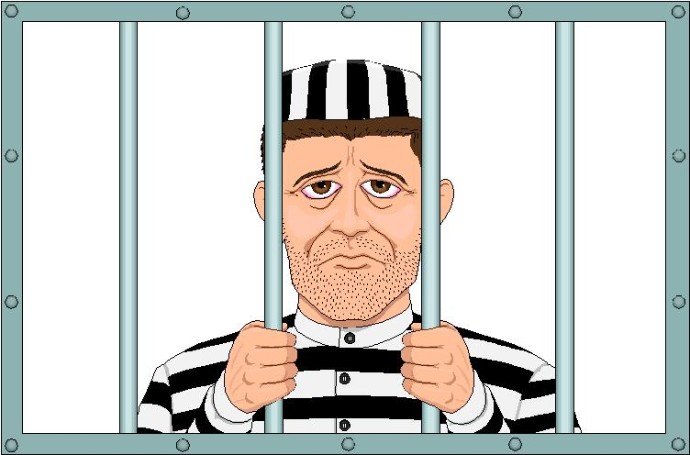
Ho Shin Lee, 31, of Los Angeles, Calif., was indicted by a federal grand jury in Charlotte on 14 counts of money laundering, according to a news release from the U.S. Attorney’s Office in the Western District of North Carolina.
Lee is facing a maximum of 20 years in prison and a $500,000 fine for each of the 14 counts.
Appalachian State University got back $1.54 million through civil forfeiture proceedings against bank accounts that Lee is alleged to have set up to launder the money.

Slide 17

Loss of funds due to unconfirmed changes made to the vendor’s direct deposit bank account information
Reputational damage from the negative publicity

Slide 18
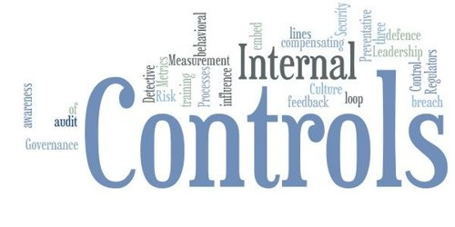
Verify the direct deposit bank account change with the vendor.
Validate that the employee worked for the vendor.
  The genuine company’s web address was rodgersbuilders.com, but the email used in the scheme was sent from accounts@rodgersbuildersinc.com.
Require that a lien waiver be submitted at the same time as the payment request.

Slide 19


Based upon fraud alerts, Accounts Payable (AP) have enacted “best practices” related to direct deposits as of April 17, 2017. Below is a list of changes:
All direct deposit changes for vendors must be done using the Direct Deposit Vendor Authorization Form.
Once the form is received with the changing banking information, Accounts Payable will contact the company to verify the validity of the change. The contact information to reach the company must come from preexisting contact information in Banner and not from the change forms received.

Slide 20

Definition of Phishing: Identity theft scam that allows an individual to gain access to sensitive or personal business information that can be used to steal identities, monies, and more.
In August 2018, North Carolina A&T and Elon reported that they were hit with a phishing email scam.
The hacker obtained access to campus email addresses and sent an email to the payroll office to change a direct deposit account to a cash card based in California.
Additional impacts:
Hacker deleted access to the employee’s paystub.
One other employee’s paystub was deleted, but their salary payment wasn’t re-routed.

Slide 21
Financial losses due to diverted funds and/or equipment failure.
Resource losses resulting from staff members losing valuable time to fix the damage.
Reputational damage from the negative publicity.

Slide 22
Employee education and training. Never click on links in an email-always type the address directly into the address bar.
Use hard to guess passwords (short phrases) and change them frequently. Treat them like the keys to the kingdom.
Keep systems current with the latest security patches and updates.
Install antivirus software, updates, and monitor the results.

Slide 23
The university’s online Security Awareness training program
  Training includes several videos.
  Employees are encouraged to complete the Security Awareness Training module in Canvas.
DUO two-factor authentication (Required for university employees in early 2019)
  Adds an extra layer of protection to your NinerNET account by requiring two factors to verify your identity.
  Effective method for preventing unauthorized access to many university systems including Gmail, my.uncc, Banner, Dropbox, Kronos, and Canvas.

Slide 24

FBI Warns of Phishing Fraud Schemes Targeting Universities and their Students:
As of May 2017, financial losses to higher education institutions have approached one million dollars in some recent incidents.
Common Schemes
Vendor Bank Account Scams
  Scammers spoof the actual email address of the vendor company.
  Pose as a vendor on a project (i.e. construction) and direct emails to the university’s accounting office with bank account changes for future payments.
W-2 Scams
  Scammers pose as high level executives (such as the university president) when requesting W-2 information from payroll employees.
Payroll Schemes
  Scammer purports to be a university executive and sends a spoofing e-mail with a PDF attachment. Upon opening the PDF, the user is prompted to enter log-in credentials.
  The scammer uses the credentials to log into the payroll system and changes the employee’s deposit information to have payments sent to a pre-paid credit card.

Slide 25

Definition for Conflict of Interest: An incompatibility between one’s private interests and one’s public or fiduciary duties.
Special Review of Campus Services Finds Wasted Money, Nepotism
Excerpt taken from the Atlanta Journal-Constitution, Aug 12 ,2018
In May 2018, a whistle-blower complained to the Georgia Tech University System’s ethics hotline regarding a possible conflict of interest that existed.
An investigation revealed that former Executive Vice Presidents Steve Swant, Lance Lunsway, Thomas Stipes, and Paul Strouts exploited relationships with vendors by getting a school vendor to pay for the following:
  Football Suite
  Expensing after-hours dining and drinking
  Playing golf with vendors during work hours
Swant also received pay from a company for serving on its board.

Slide 26
Misuse of University resources (time and money)
Appearance of impropriety
Reputational damage from the negative publicity

Slide 27
Tone at the Top - Investigators found that the culture at Georgia Tech was “an environment of the wild, wild west. People feel like they can do what they want.” Senior Management’s behavior sets a role model for others.
Require ethics training for Faculty and Staff (at least annually).
Require individuals to complete a conflict of interest declaration (at least annually).
Need to update the manual expense reporting to an electronic process.

Slide 28
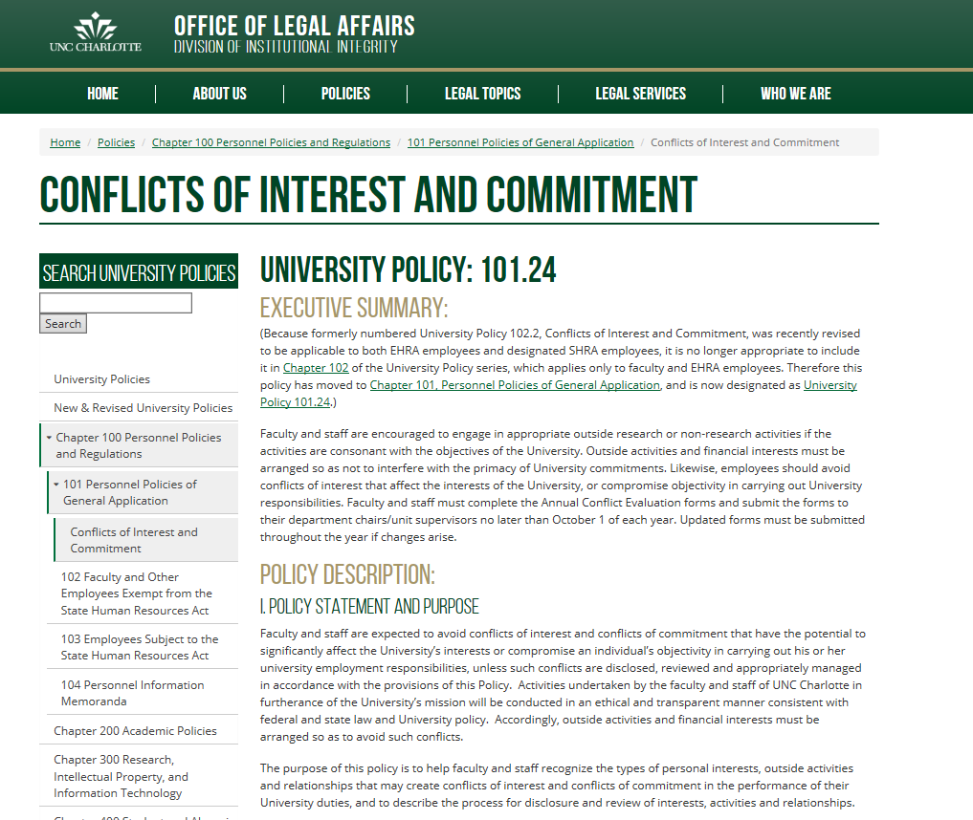

Slide 29
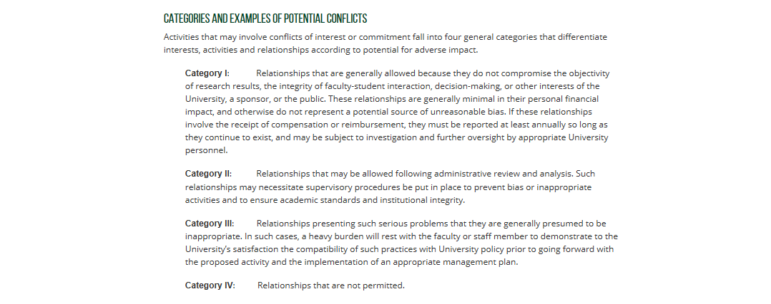

Slide 30

Additional Internal Audit Services
Evaluate and make recommendations where needed in:
  Policies and procedures
  Internal controls
  Process changes
Conduct audit education
Perform process reviews
Investigate (ethical and compliance) fraud

Slide 31


