Slide 1
Legal Whack-A-Mole:
Addressing the Pesky Student
Issues that Inevitably Pop Up
October 16, 2018
Sarah O. Edwards
Associate General Counsel

Slide 2

Agenda
FERPA overview
FERPA scenarios
First Amendment overview
Free expression scenarios

Slide 3
FERPA Overview

Slide 4
Family Educational Rights and Privacy Act (FERPA)
Federal law enacted in 1974
Protects students’ education records from being disclosed without consent (or other exception)
Permits a student to access his/her own education record
University Policy 402, Student Records
  http://legal.uncc.edu/policies/up-402
  also, short training module on OLA website

Slide 5

Family Educational Rights and Privacy Act (FERPA)
“Education record” is any record that is:
  Directly related to the student and
  Maintained by the university
Examples include:
  Personal information (that’s not directory information)
  Grades
  Schedules
  Disability status
  Disciplinary issues
  Immunization records, CBCs, etc.
  Written communications with or about a student

Slide 6

Family Educational Rights and Privacy Act (FERPA)
NOT education records:
  campus police records
  employment records (unless dependent on student status)
  peer-graded assignments BEFORE collection
  treatment records (medical/counseling)
  certain alumni records
  your observations about a student

Slide 7
Family Educational Rights and Privacy Act (FERPA)
NOT education records (cont’d):
  personal notes =
    in the sole possession of the maker,
    are used only as a personal memory aid, and
    are not accessible or revealed to any other person except a temporary substitute for the maker of the record
* If your notes are stored on shared drives, in office file rooms, or in a software system that is accessible by others, they do not meet the personal notes exception.

Slide 8
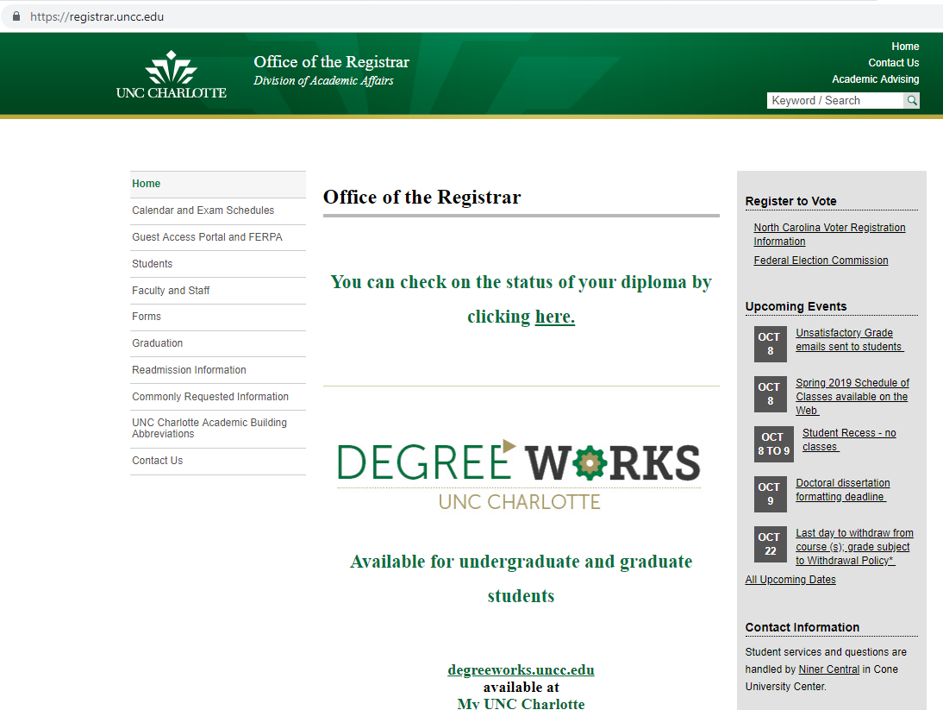
Family Educational Rights and Privacy Act (FERPA)
Student may consent to the disclosure of education records
  Guest Access Portal OR
  Electronic or paper form
    Student’s presence and lack of objection is not sufficient.

Slide 9
Family Educational Rights and Privacy Act (FERPA)
Acceptable electronic consent
  An email from the student’s official UNC Charlotte email address
  Consent provided through the Guest Access Portal
  Any paper or online form that includes:
    A handwritten signature on a document, including when the entire document is scanned or faxed to the university
    A graphic image of a signature placed on a document using secure software that verifies the identity of the user on the other end (e.g. DocuSign)
    Marks, initials, or checkboxes provided through an online form that is accessible only after inputting one’s NinerNet credentials and is tied to that individual’s NinerNet account (for student or employee signatures)
* More information is available at https://legal.uncc.edu/legal-topics/contracts/guidelines-accepting-digital-or-electronic-signatures

Slide 10
Family Educational Rights and Privacy Act (FERPA)
Exceptions:
  To university officials if legitimate educational interest
  To parents if student is dependent
  To another university if student transfers
  Health/safety emergency
  Judicial order/subpoena
  Certain disciplinary information
    crimes of violence (just victim or victim and public) or
    alcohol/drug violations (if responsible)

Slide 11
FERPA Overview
Exceptions (cont’d):
  Directory information = information not generally considered harmful or an invasion of privacy if shared
    Unless privacy hold (on file with Registrar)
    At UNC Charlotte (UP 402), directory information is only:
      Student’s name
      Major field of study
      Dates of attendance
      Enrollment status
      Degrees and awards (including scholarships) received
* Student images (photos, videos, etc.) and student email addresses are only considered directory information if they are: (1) used in official University publications/websites or (2) required to be disclosed via contract.

Slide 12
FERPA Scenarios

Slide 13
Scenario
The psychology department plans to host an event for senior psychology majors. Students can visit with a variety of potential employers as well as vendors who want to showcase the latest technology that can aid the students’ future practice.
  Several vendors want the email addresses of the students who will be attending the event to provide them information ahead of time and encourage the students to stop by their tables. Can you provide those?
  Several potential employers plan to ask the students that visit their tables to provide their GPAs. Is that permissible?
  The department wants to include pictures of the event on its website, which will likely include students and faculty as well as employers and vendors. Is that okay?
  One vendor asks if it can include some of the pictures the university takes at the event on its website. Is that okay?

Slide 14
Scenario
One of your students has been placed in an internship with an off-campus facility as part of the practical experience required for her degree.
  The facility needs a clean criminal background check and a clean drug screening for the student before she begins her internship. Can the university share that information with the facility?
  Your facility liaison tells you that the facility might be interested in hiring the student when she graduates. You know that the student is currently failing a required class and will not be able to graduate if she does not raise that grade. What can/should you share with the facility?
  At a check-in, the student mentions to you that an employee at the facility pays a lot of attention to her, including making multiple comments about her physical attractiveness. It sort of creeps her out. With whom can/should you share this information?
  Your next door neighbor also works at that facility and asked you if any of your students are interning there this semester. What can you tell him?

Slide 15
Take Aways
Limited use directory information (pictures and email addresses) can only be disclosed if you comply with the policy requirements (UP 402)
FERPA governs all the student information an academic department collects, even if it looks medical (immunization records, drug screen records, etc.)
FERPA requires either:
  Written consent from each student, or
  Provision in an agreement that the other party is considered a university official and agrees to comply with the requirements of FERPA, or
  Another exception
Even with consent, a contract provision, or an exception, you should not disclose more information than is necessary

Slide 16
First Amendment

Slide 17

First Amendment
“Congress shall make no law . . . abridging the freedom of speech”
As a public institution, UNC Charlotte must comply with the First Amendment with respect to students, faculty, staff, and the public
  But the rules are different depending on the constituency and the forum
Speech can be:
  What someone says (in class, at SoVi, at BOT meeting, etc.)
  What someone wears
  What someone writes/posts (on bulletin boards or online)
  What someone does (displays flag, gives middle finger, etc.)

Slide 18
First Amendment
Legally, speech/expression is generally protected
  “The Government has an interest in preventing speech expressing ideas that offend. And, as we have explained, that idea strikes at the heart of the First Amendment. Speech that demeans on the basis of race, ethnicity, gender, religion, age, disability or any other similar ground is hateful; but the proudest boast of our free speech jurisprudence is that we protect the freedom to express ‘the thought that we hate.’” Matal v. Tam (2017)
Practically, being exposed to a variety of viewpoints and engaging in debate are invaluable to a healthy academic environment

Slide 19

First Amendment
Unprotected speech
  True threats
  Fighting words*
  Speech that incites imminent lawless action
  Obscenity/child pornography
  Unlawful harassment
  Defamation
* so narrow that it’s almost no longer an exception

Slide 20
First Amendment
The university can make content-neutral rules governing the time, place, and manner of speech, such as:
  No disruption of normal university function, including classes
  No vandalism/destruction of property
  No posting signs on walls of university buildings except in specified places
  No using sound amplification
The rules also have to be narrowly tailored to serve a significant government interest and leave open alternative channels for speech.

Slide 21
First Amendment
Traditional public forum (e.g. streets, sidewalks, Belk plaza, CHHS/COED plaza)
  Reasonable time, place, and manner restrictions
  Content-neutral, viewpoint-neutral
Limited public forum (e.g. university website, SGA meeting)
  Reasonable time, place, and manner restrictions
  Specified topic or specified invitees, viewpoint-neutral
Nonpublic forum (e.g. classrooms, staff meetings, offices)
  May or may not be permitted to speak
  Restrictions still must be viewpoint-neutral

Slide 22
First Amendment Scenarios

Slide 23
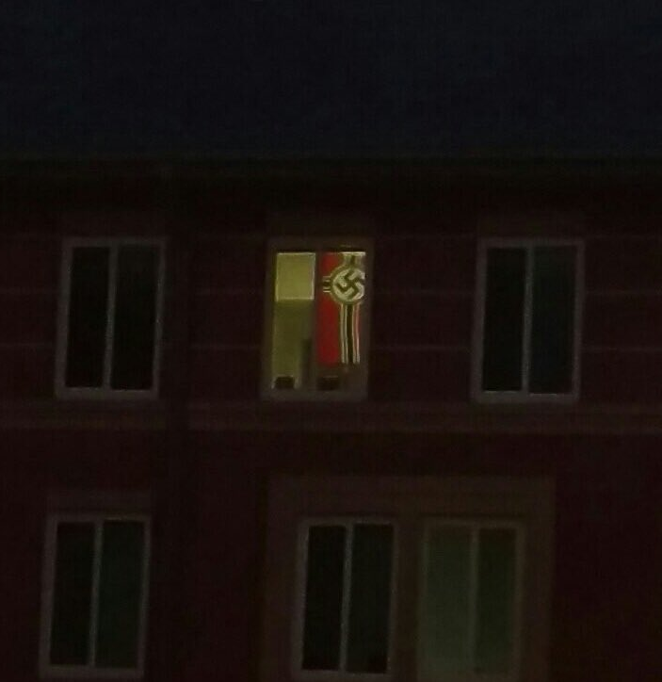
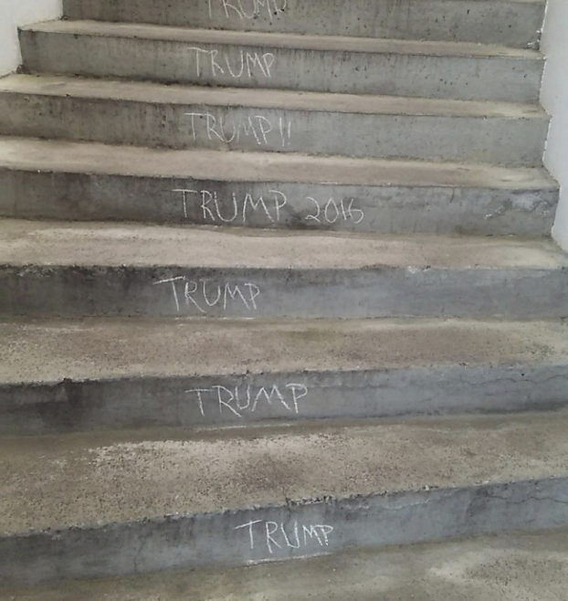
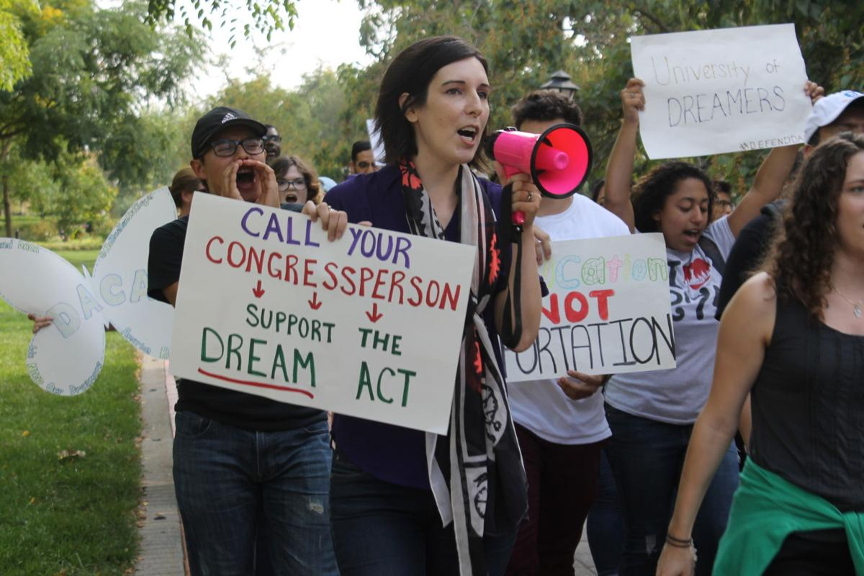
Scenario

Slide 24

Scenario

Slide 25

Scenario

Slide 26
Questions?

