Slide 1
What Researchers Need to Know about Patents
Carl P. B. Mahler, II
Executive Director, Office of Technology Transfer

Slide 2
What is IP?
“Property” is not what you think it is
  It is a set of rights
  The most important right is the right to exclude others
IP is not like real property
  More than one person can use the same IP at the same time
  Sharing it with others doesn’t restrict my right to use it
Having IP Rights doesn’t mean you can use the IP yourself

Slide 3
Main Types of IP
Trade Secrets – things you keep secret that give you a commercial advantage
Trademarks – indicates sources of good
Copyrights – protect your expression of ideas
Patents – protect the practice of ideas

Slide 4
Philosophical Basis for IP
Society is benefited by providing incentives for people to create new things
Society benefits even more by eventually allowing everyone to use or copy the new idea
IP is a compromise, giving creators a monopoly for a certain period of time but eventually allowing the creation to lapse into the public domain

Slide 5
Important Aspects of Patents
Patents are Granted by the Government
  Getting a patent in one country doesn’t give you patent rights in other countries
  Patents last for limited amounts of time, determined by the government
Having a patent means you can exclude others from practicing your patent idea
  Does not mean you can use it yourself

Slide 6
Rights and Requirements for Patents
A patent lets you stop others from making, selling, using, and importing the covered invention
To get a patent, your idea must be new, useful, and non-obvious
  Non-obvious to a person of ordinary skill in the relevant art
Last 20 years from “priority date” (in US)

Slide 7
Parts of a Patent
First page information (inventor, owner, abstract, date filed, date issued, patent number)
Drawings
Disclosure (background, summary, detailed description, preferred embodiment)
Claims

Slide 8
Harsh Realities of Patent Law
Patents are expensive (about $20,000 in US)
Patents take a long time to issue (about 3 years in the US)
It is VERY easy to lose your rights to a patent
Enforcement is horrendously expensive (between $5 million and $15 million for each side in a patent dispute, on average)

Slide 9
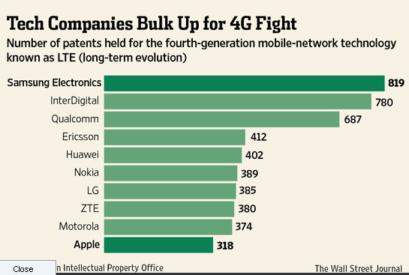
Apple v Samsung
Currently involved in over 50 patent lawsuits around the world.
Apple won the latest suit and was awarded $1 billion in damages.
Samsung is ready for a fight as they hold the most LTE related patents.

Slide 10
Patent Process
File provisional application (optional)
File utility application (wait 6-36 months)
Patent office splits claims, requires you to choose which “invention” to prosecute (wait 3 months after choosing)
Patent office rejects claims, you respond (repeat up to three times)
Claims accepted or rejected
Pay fee, patent issues in about 3 months

Slide 11
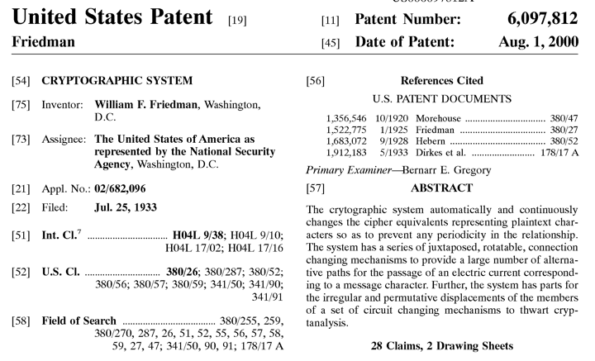
How long can it take for a patent to issue?

Slide 12
Recent Changes to US Patent Laws
Changed from “First to Invent” to “First to File”
Retains one year grace period from disclosure
Allows third parties to challenge pending applications and patents (within first 9 months of issuance)
Provides sufficient funding for patent office (finally!)
New patent law has now basically been phased into effect; the US Patent Office is still learning the rules
Judicial Trend: “Non-practicing entities” (or NPE’s) may not have rights that are as strong as patent rights of “practicing entities”

Slide 13
Ownership of Patentable Inventions
University claims ownership of inventions made using University time, staff, materials, information not available to public, or funds.
University owns inventions resulting from contracts, grants, or other agreements.
University does NOT own inventions made on university personnel’s own time an not using university resources

Slide 14
Responsibilities of University Inventors
Inventions that may belong to the university must be disclosed to the Office of Technology Transfer
Inventors must notify the Office of Technology Transfer of any publication, sale, or public use of an invention in which the University has rights
University personnel may not enter into agreements that would obligate inventions owned by the University to any other party

Slide 15
Rights of Inventors
Inventors may request that the Univerity formally acknowledge that it has no rights in inventions made on the inventor’s own time
Inventors share in the net income received from the university’s commercialization of inventions
Inventors share equally unless they all agree in writing to a different distribution

Slide 16
Questions?

