Slide 1
Set the Record Straight…An Insider’s Guide to Public Records
Tina Dadio, Public Records Officer/Legal Specialist
Amanda Simpson, Paralegal
October 16, 2018
Legal Symposium
Office of Legal Affairs
UNC Charlotte

Slide 2
Agenda
Public records overview
Past vs. present changes in public records request
State (PRA) vs. Federal laws (FOIA)
Complex requests
Processing requests
Exceptions

Slide 3
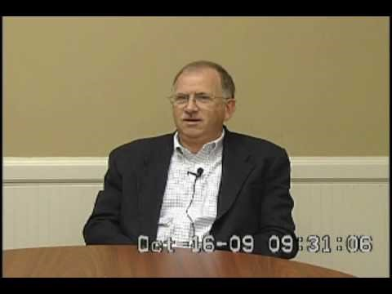
Why training is important?
Walton County officials testify in depositions about the handling of public records.
https://www.youtube.com/watch?v=G9okNmDiGJk

Slide 4
What is a Public Record?
All documents of any type “regardless of physical form or characteristics…made or received in connection with the transaction of public business by any agency of North Carolina (NCGS 132-1(A) )
Note: ▶ UNC Charlotte is considered a state agency
Disposition of records are governed by law: NCGS 121 (Archives & History) & 132 (Public Records Act)

Slide 5



Public Records Requests… transparency…transparency…transparency
PAST
PRESENT
Past: Nick Shepherd / Getty Images
Present: https://www.lmktec.london/insights/future-of-office-communications/

Slide 6
Shift in Public Records
PAST Litigation Media Political Voluminous paper copies | PRESENT All included PLUS: Advocacy groups Political activists Technology advances (Cell phones, Tablets, Text Messages, Video Chat, Instant Messaging, etc.) Electronic/digital records Aggrieved and unhappy people (contractors/bidders, etc.)

Slide 7
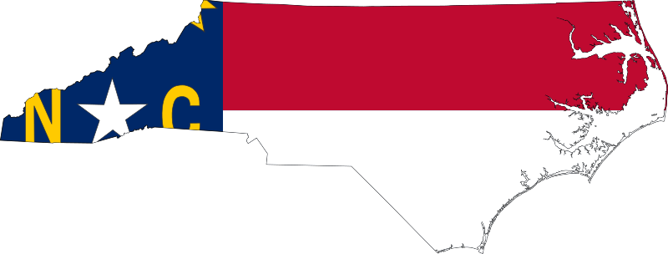
State vs. Federal
State
  NC Public Records Act (NCGS §132-1 et. seq.)
  Respond to request “as promptly as possible”
Federal
  FOIA (Freedom of Information Act)
  Government agencies must respond in writing within 20 business days (note: does not necessarily mean records need to be delivered within this time frame)

Slide 8
Public Records Data
Year | # Requests Received | # of Hours Related to Review | % Hours Related to Redaction
2014 | 91 | 82.10 | 70%
2015 | 96 | 182 | 75%
2016 | 174 | 232.9 | 80%
2017 | 220 | 324.00 | 90%
Note: 20% increase in requests from last year

Slide 9
Public Records Process
Receipt of request
Analyze request
Contact custodian of record
Review production document(s)
Redact document (s)
Prepare document(s) for delivery to requester
Forward document(s) to requester
File and log details

Slide 10
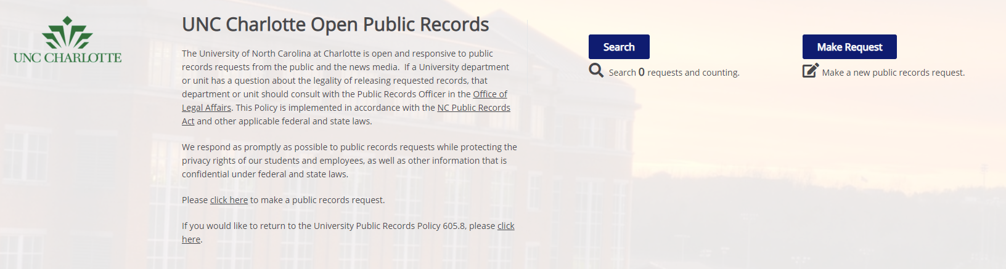
Tracking
https://unccharlotte.nextrequest.com

Slide 11

Notification
Notifying requester:
  Initial email acknowledging receipt
  Provide status update if more than 30 days
  Contact requester to determine how they want the records sent
In North Carolina, public records are responded to “as promptly as possible”
  Considerations:
    Scope of request
    Method of delivery
    Payment for “extensive clerical services”

Slide 12
Communication is the key!
Vague Requests
Example: “Please provide me with copies of all emails related to last week’s article about UNC Charlotte”.
Questions we may ask:
  Does any part of the request make sense?
    Start with what you know
  Can we ask for clarification from the requester?
    Ask for more information on the “unclear” portion
    Put the onus on the requester
  Can we negotiate “search terms” to narrow scope?
    Work with requester
  Confirm in an email or letter the agreed upon search terms

Slide 13
Complex Requests
Strategize!
The “any and all” requests:
Questions we may ask:
Where do we start?
Who are the custodians?
Do we need to contact University Communications?
What exactly are they requesting? (emails, hard copies or both?)
How many documents are responsive?
Are there documents we can easily gather?
Is this considered “extensive services” or labor intensive?
Can the requester clarify or narrow the scope of the request?
Can we negotiate search terms?

Slide 14

Text Messages
What do you mean I have to show you my text messages?
Content NOT location determines the public record
  Remember this includes: records made or received in connection with the transaction of public business
May include:
    personal computers
    smart phones
    iPads
    tablets
    voice mails

Slide 15
Best Practice
What if an employee at UNC Charlotte directly receives a public records request?
Administrators, faculty, and staff who receive a public records request should notify the Public Records Officer
Consultation should take place prior to any record being released by the University

Slide 16

Exceptions
Personnel records: employee personnel records are confidential pursuant to North Carolina State Human Resources Act (except certain records subject to NCGS §126-23 (a) (1-12)
Attorney-client privilege: confidential communications subject to NCGS §132-1.1
Trade secrets: prohibits access to business trade secrets that have been shared with the government, as long as the business designated the material as confidential or trade secret at the time it was disclosed to the agency
Certain criminal investigation and law enforcement records

Slide 17

Exceptions
Student Records
    At UNC Charlotte: “Directory Information” includes:
        Student’s name
        Major
        Field of study
        Dates of attendance
        Enrollment status
        Degrees and awards (scholarships)
Students have the right to see their file and under FERPA, you have 45 days to respond to such requests

Slide 18
Public Access
  What if a requester is denied access to a public record?
    Anyone who is denied access to public records may seek a court action to compel the State agency to turn over the records. (NCGS§132-9(a))
    Burden is on the State (NCGS§132-9(b))
    Presumption is that all State records are public

Slide 19
Legal Holds
“Litigation holds” are usually issued when there is a pending or threatened litigation
You are required to suspend normal and routine destruction of records regardless of the established record retention schedule
Upon notice you are also required to:
  Recipient MUST acknowledge receipt
  Immediately suspend deletion of relevant records
  Preserve any electronic records generated OR received after receipt
  Preserve hard copies of documents under your control
  You MUST continue to monitor compliance

Slide 20

Violation of Legal Holds
It is against the law to destroy, alter, withhold, or obscure “evidence” once a legal hold has been initiated
This is referred to as “spoliation”
Some courts have sanctioned spoliation by awarding attorneys’ fees, fines, and punitive damages

Slide 21
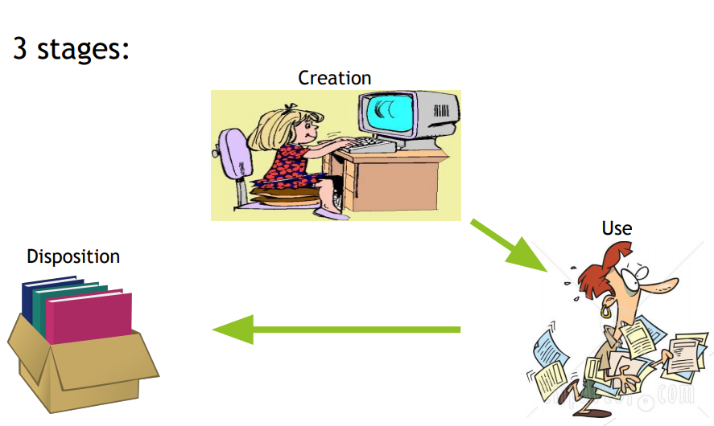
Life Cycle of a Record

Slide 22
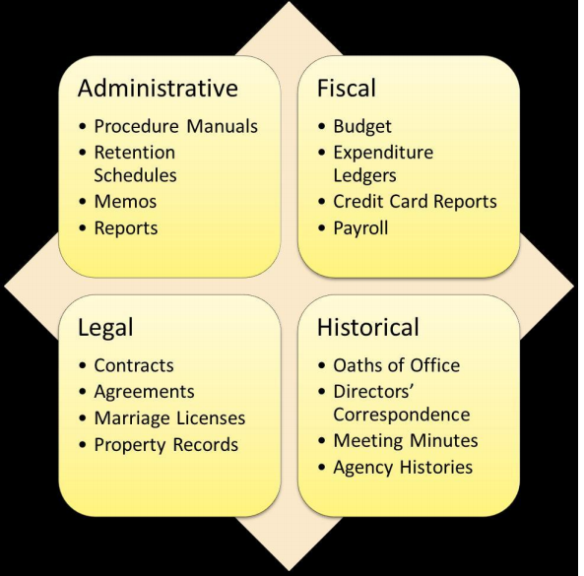

Four main values of a record

Slide 23
Tracking and Retention
Identify a responsible person for archiving in your area
Adopt an internal policy on archiving, if needed
Inventory documents in your area (monthly, bi-annually, annually)
Purge documents accordingly
Train new employees/attend workshops
Familiarize yourself with the Retention Guidelines and Schedule (https://legal.uncc.edu/policies/up-605.3)

Slide 24

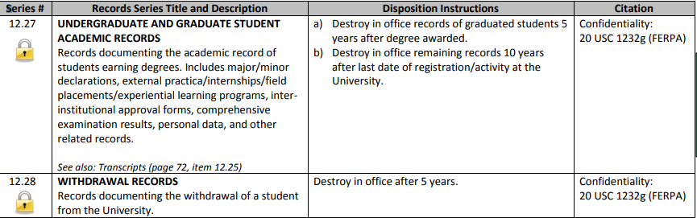
Retention and Disposition
Example
Graduate Student X Degree awarded May 10, 2013
Shred after May 11, 2018 (5 years after)
Few exceptions:
Disciplinary records, FERPA forms, theses/dissertations, transcripts, transfer records
Important to review Retention Schedule (UP 605.3)

Slide 25
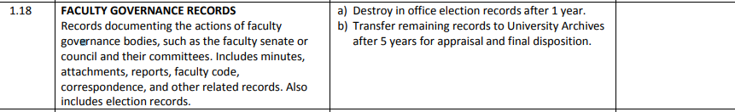
Retention and Disposition
Example
snip
Faculty Governance Records
Shred election records (1 year after)
Transfer remaining records to University Archivist

Slide 26
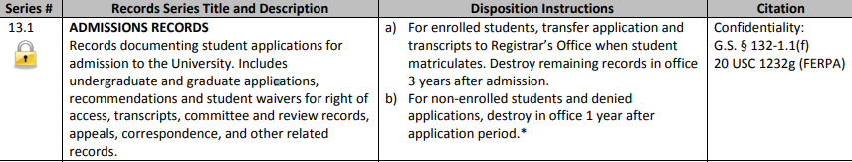
Retention and Disposition
Example
snip
Student Admissions Record
8/20/2018
Send transcript and application to Registrar’s on 8/20/2018
Destroy remaining records on or after 8/21/2021 (3 years after admission)
If not enrolled or denied admission, destroy 8/21/2019 (1 year after application)

Slide 27

Retention and Disposition
Example
snip
Tracking Materials
- Certified mail receipts, postage authorizations
Destroy when reference value ends.
What does this mean?
When should we destroy it?
Reference value???

Slide 28
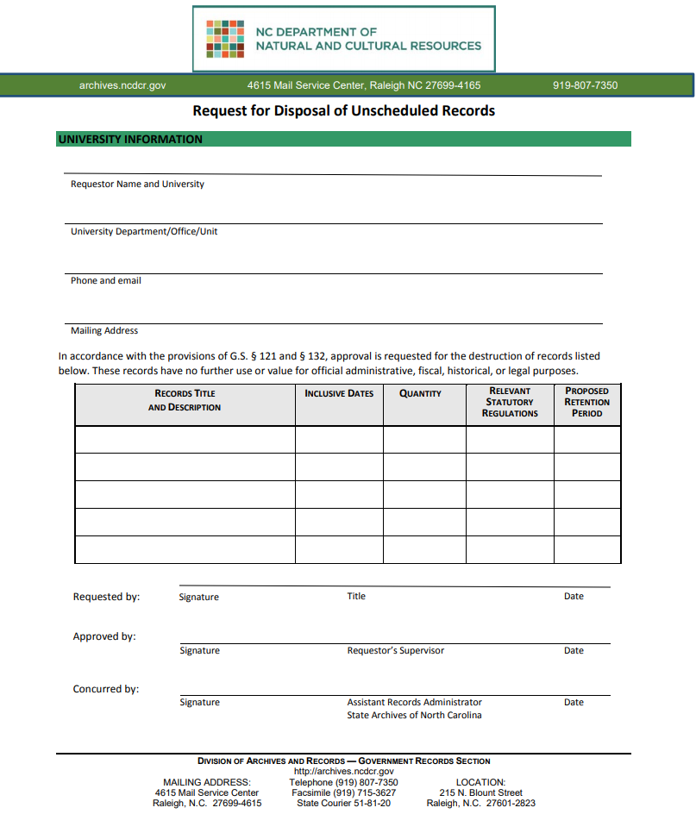
Determine when the reference value ends
Contact University Archivist
Complete form
Create an internal policy for that specific record
Example:
1/2/2017 Certified return receipt documentation
Package delivered and received on 1/3/2017
Reference value has ended
Determine value ends 1 year after
Destroy on 1/3/2018

Slide 29
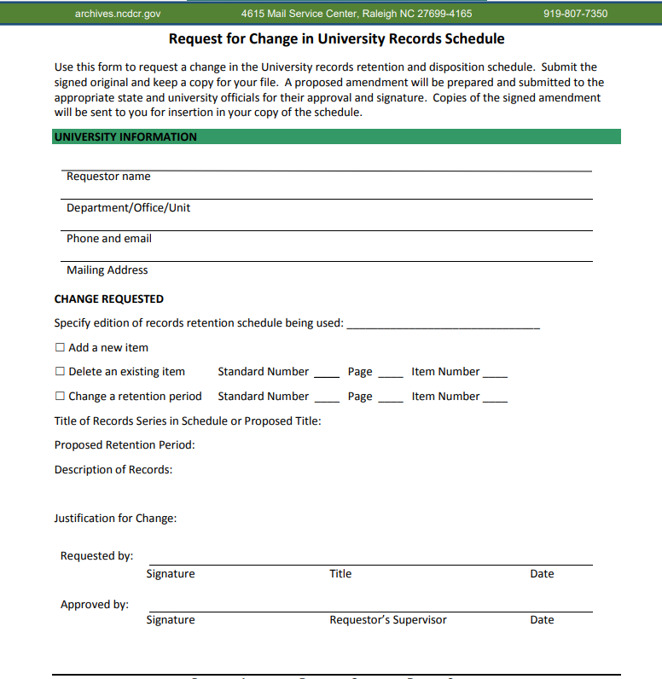
If you need to change the retention or disposition date of a particular record
Contact University Archivist
Complete form
Create an internal policy for that specific record

Slide 30
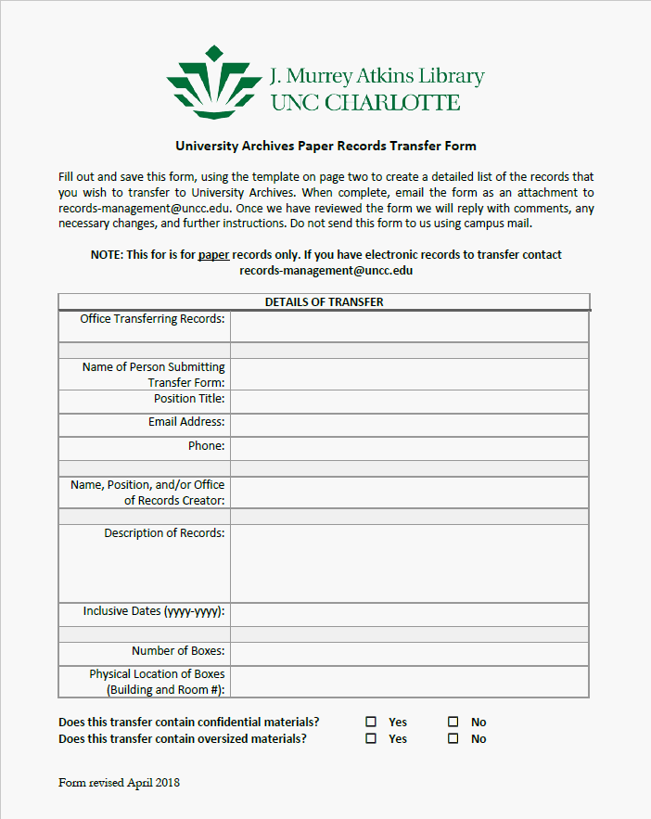
Use this form when sending records to University Archivist

Slide 31
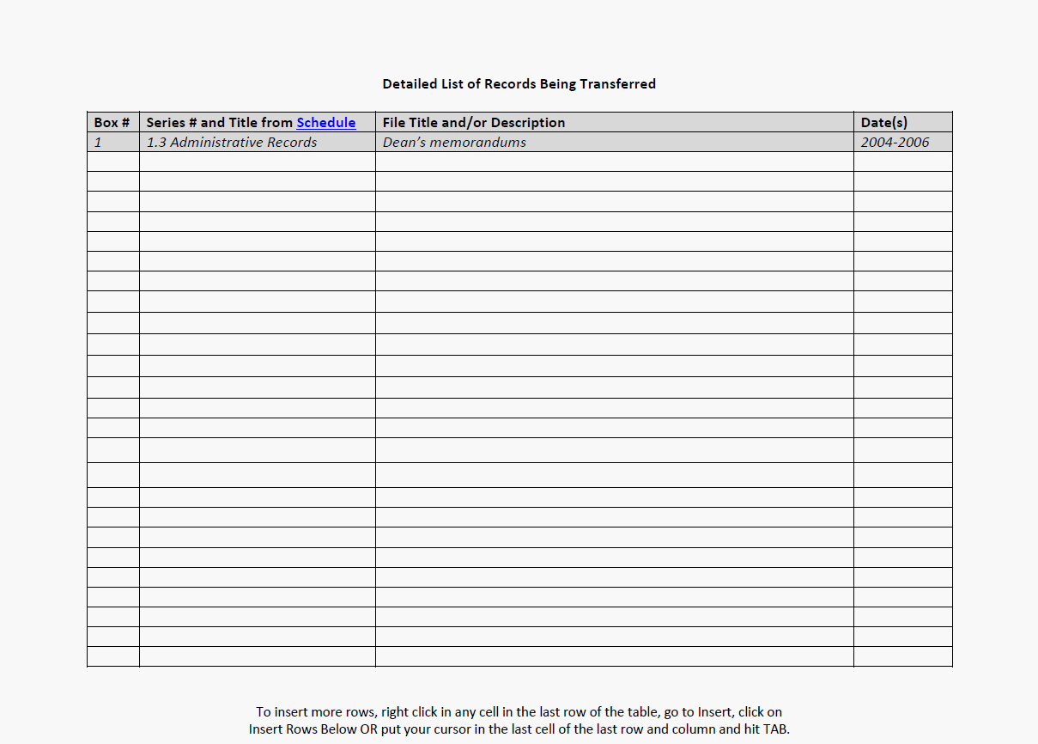
Tracking
Example
Maintain this log in office to track your transferred records

Slide 32

QUESTIONS?

