Slide 1
Campus Safety and
Security Committee/
Campus Behavioral Intervention Team
Office of Legal Affairs Faculty Symposium
October 30, 2013

Slide 2
Campus Safety and Security Committee
Composition
Chief of Police and Associate Vice Chancellor for Risk Management, Safety and Security
One-year student appointments (SGA president and GPSG representative)
Remainder serve staggered 3-year terms (two faculty members, Legal Affairs, International Programs, HR, Counseling, Center for Wellness Promotion, Advancement, Disability Services, Housing, Facilities, Academic Affairs, Dean of Students office, Business Affairs)

Slide 3
Campus Safety and Security Committee
Committee Charge
Develop and implement a comprehensive safety and security plan.
  Crime prevention
  Safety education
  Threat assessment
  Alcohol/drug education
Recommend changes in policies or procedures.
Place financial expenditures in priority order.
Focus on threats from criminal and violent behavior, not “all hazards.”
Annually assess results.

Slide 4
Campus Safety and Security Committee
Get Involved
Meetings
campussafety.uncc.edu
  Committee information/updates
  Annual reports
  Contact form
  Emergency contact information/incident report link
police.uncc.edu
  Clery Act annual security report
  Training videos
  Complaints/commendations

Slide 5
Campus Behavioral Intervention Team (CBIT)
Composition
The following individuals (or designees) as permanent members:
  Dean of Students, as Chair
  Director of the Counseling Center
  Director of Police and Public Safety
  Director of Housing and Residence Life
  Associate Provost for Academic Services
  Senior Associate Dean of Students
  Dean of the Graduate School
Alternates and invitees (Legal Affairs, HR)

Slide 6
Campus Behavioral Intervention Team (CBIT)
CBIT Charge/Mission
Charge (University Policy 408, Student Involuntary Protective Withdrawal Policy)
  “ . . . to meet regularly, and on an emergency basis as necessary, to discuss issues relating to student behavioral concerns.”
Mission:
  Review situations involving students who have demonstrated behaviors of concern;
  Recommend appropriate intervention strategies;
  Provide training and awareness regarding behavioral concerns to the campus community.

Slide 7
Campus Behavioral Intervention Team (CBIT)
Students of Concern
Definition:
  “ . . . a student who is suffering from a medical or psychological disorder and, as a result of the disorder, presents a direct threat to the health or safety of others.”
Relationship to Conduct Process:
  “Involuntary protective withdrawal is not a substitute for appropriate disciplinary action.”

Slide 8
CBIT/Conduct Intake Process
incidentreport.uncc.edu
Office of the Dean of Students
Possible outcomes:
No action
Faculty/staff follow-up
Housing & Residence Life follow-up
Counseling Center referral
“Care and concern” meeting
Police check-in
Parental contact
Referral to conduct process
Voluntary withdrawal
Interim protective withdrawal
Involuntary withdrawal
Hospitalization

Slide 9
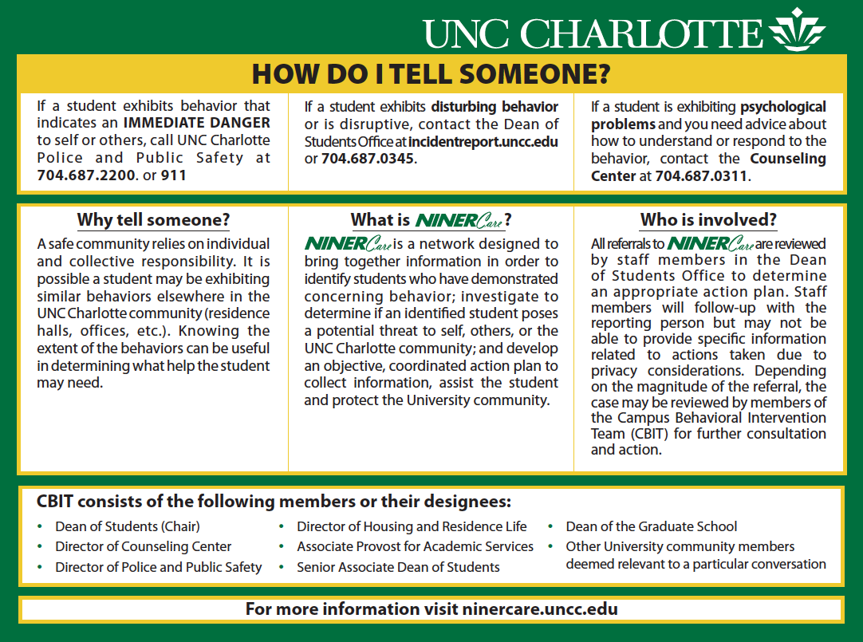

Slide 10
Impact of Mental Health Issues on Academic Performance and Retention

Slide 11
Impact of Mental Health Issues on Academic Performance and Retention
Goals
  Briefly review some research on the impact of mental health concerns on academics.
  Share data about what UNC Charlotte students tell us about impact of mental health on academic performance.
  Suggest ways faculty can help.

Slide 12
The Impact of Mental Health
Developing depression was the most critical event that led students to consider withdrawing from the university (Pleskac, et al., 2011).
Students with mental illness report less engagement on campus and poorer relationships, factors that were associated with lower graduation rates (Salzer, 2012).

Slide 13
Other findings
Stress-related coping strategies had a direct effect on social integration and continued college enrollment (Bray, Braxton, and Sullivan, 1999).
Retention rate of students who received psychological counseling was 14% higher than for students who did not (Kitzrow, 2003).

Slide 14

UNC Charlotte students
Within the last 12 months:
  Felt things were hopeless – 44.7%
  Felt so depressed it was difficult to function – 30%
  Felt overwhelming anxiety – 47.7%
  Source: National College Health Assessment, spring 2013, n=1,171
Notes:
Extrapolating to a population of 26,000 students: over 7000 students who felt so depressed it was difficult to function and almost 12,000 with overwhelming anxiety.

Slide 15

UNC Charlotte students
Factors affecting academic performance (incomplete, dropped course, poor grade):
  Stress 27.5%
  Sleep Difficulties 18.8%
  Anxiety 18.6%
  Depression 11.9%
  Source: National College Health Assessment, spring 2013, n = 1,171
Notes:
Extrapolating to a population of 26000 students: over 5, 000 students that had so much anxiety that it lead to poor academic performance

Slide 16

Students who use the
Counseling Center
Either prior to college, after starting college, or both, students report that they have:
  Had prior counseling 49%
  Taken medication for mental health 39%
  Considered attempting suicide 30%
  Made a suicide attempt 10%
  Been hospitalized for mental health 8%
Source: UNC Charlotte Standardized Data Set, 2012-2013

Slide 17
Outcome
Over 21% of clients said they were thinking of leaving UNC Charlotte before starting counseling. Of those, 75% agreed or strongly agreed that counseling helped them stay at UNC Charlotte.
Over 30% of clients said they were having significant academic problems before starting counseling. Of those, 73% agreed or strongly agreed that counseling helped them improve their academic performance.
97% agreed or strongly agreed with the statement, "If I were to need help again, I would come back to the Counseling Center.”

Slide 18
How faculty can help
Identify and respond to students who may be experiencing psychological distress
Consult with counseling staff when you have questions
Refer students who may be in psychological distress
http://counselingcenter.uncc.edu/home/concerned-about-a-student
    Signs and symptoms of distress
    Guidelines for responding
    Consultation
    Referral guidelines

Slide 19


Gatekeeper Training
Fast, convenient, engaging
Completed in 45-minutes--in one or more sittings
Access online, 24/7
Simulation Format: Learn through virtual role-play
Practice having conversations with up to 5 virtual students
National survey at over 72 colleges and universities: 96% would recommend At-Risk to a colleague. (www.kognito.com/atrisk/research)
Notes:
After thorough research of Gatekeeper training options, we have selected and invested in an innovative online training course called At-Risk. Understanding the time crunch that all faculty share, we have chosen this training because it is fast, convenient and engaging - it can be executed in multiple sessions and can be revisited as needed (while license is valid). The At Risk training is delivered in the form of a simulation, where you take on the role of a … yes, university professor who has concerns about several of his students.

Slide 20
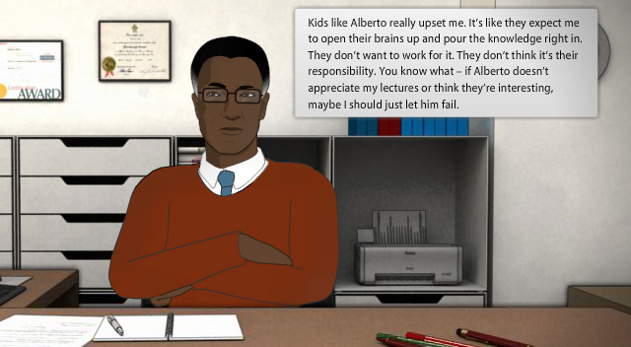
At Risk
Adopted at over 50 campuses since 2009
First simulation listed in national “best practice” registry
Created by leading experts in mental health and learning technology
National survey: 85% reported that after taking At-Risk they were more confident in their ability to help a suicidal student.
(www.kognito.com/atrisk/research)
Notes:
Although this training is new, it’s been adopted by over 50 colleges and universities across the country. It is also listed in the Suicide Prevention Resource Center/American Foundation for Suicide Prevention (SPRC/AFSP – a division of SAMHSA, the Substance Abuse and Mental Health Administration) registry of best practice programs – it is the first simulation to be included in that registry. The training was created by experts from Mental Health Association of New York City and a team of university-trained educational technologists.

Slide 21



How to Enroll
To access the course, log on to http://aruf.kognito.com (enrollment key: uncc89)
Take 45-minute course
Complete follow up survey
Return to the course as many times as you wish during the year

Slide 22

Questions?

